Slide 1


Simulation Studies of Liquid Slag Flow Patterns at High Temperatures
BTP-2 (MTY401U4M)
Under the Guidance of: Presented by:
Dr. Srishilan C Om Prakash Gadhwal
2021umt0183
1

Slide 2
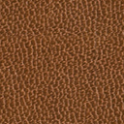
Background
By product of Metal extraction
Slag
SiO₂ , Al₂0₃, CaO, MgO, FeO or Fe₂O₃
Composition vary
Metal Oxides
Cement
Brick
Powder Metallurgy route
Utilization
Ceramic Processing Technique
Ballast
Road etc.
Ground Slag(GS)
2

Slide 3

Objective
Molten Slag
Water Quenching
Cooled Slag
Grinding
Ground Slag
Heat Loss
Flow Study
Develop technology to process slag
Without Heat Loss
3

Slide 4
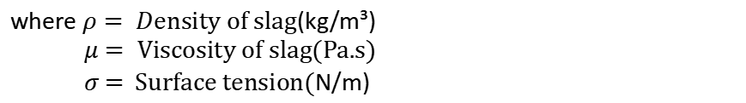
Study
Cold Model
Computational Model
Water or Wax
Flow Pattern
$$f\left(ρ,μ,σ\right)$$
where $ρ= D$ensity of slag(kg/m³)
$μ=$Viscosity of slag(Pa.s)
$σ$ = Surface tension(N/m)
4

Slide 5
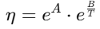
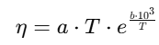
Flat Surface
Rotating Disk
Numerical Model of Flow
Circular Tube
Literature Data
Research Paper | Model | Equation | Viscosity Range(Pa.s)
Jia, 2019, pp. 2-3 | Arrhenius Temperature Model |  | 1.3 - 2.6
Hurst, 2000, pp. 1-2 | Arrhenius Temperature Model |  | 0.7 - 32
Arman, 2017, pp. 2-7 | Urbain composition model |  | 0 - 15
5

Slide 6
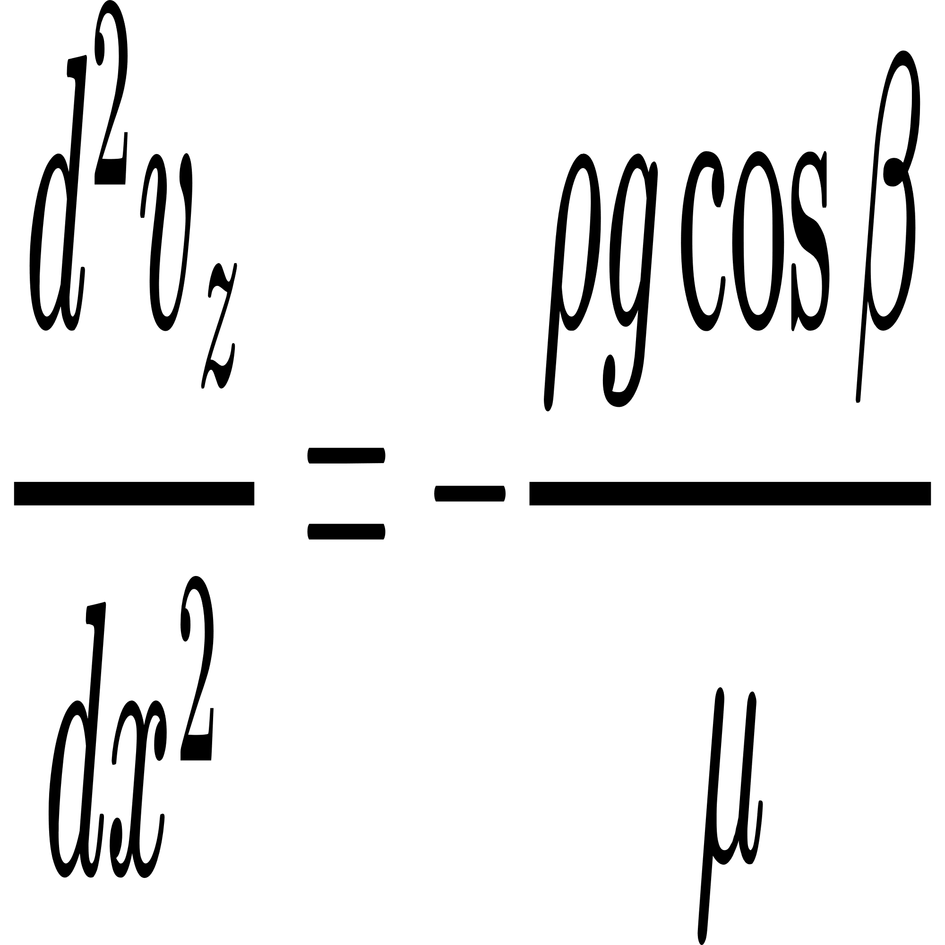
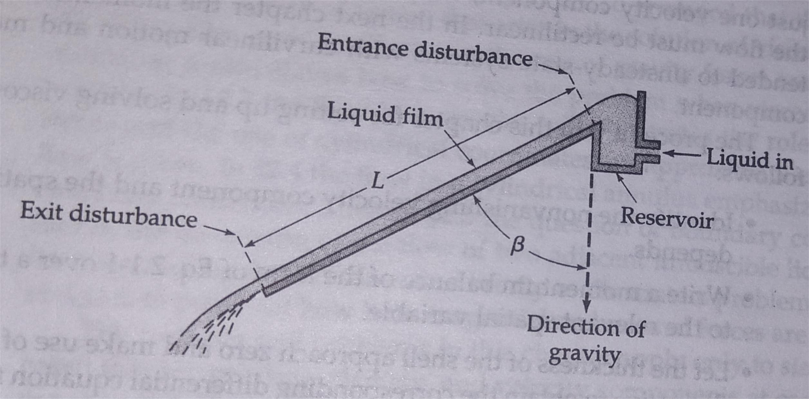
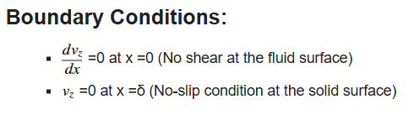
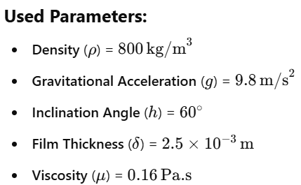
1. Flat Surface
Second-order differential equation:
After Applying Shell Momentum Balance to Steady Flow
Ref:- Transport Phenomena(R.Byron Bird, Warren E. Stewart, Edwin N. Lightfoot)
6

Slide 7
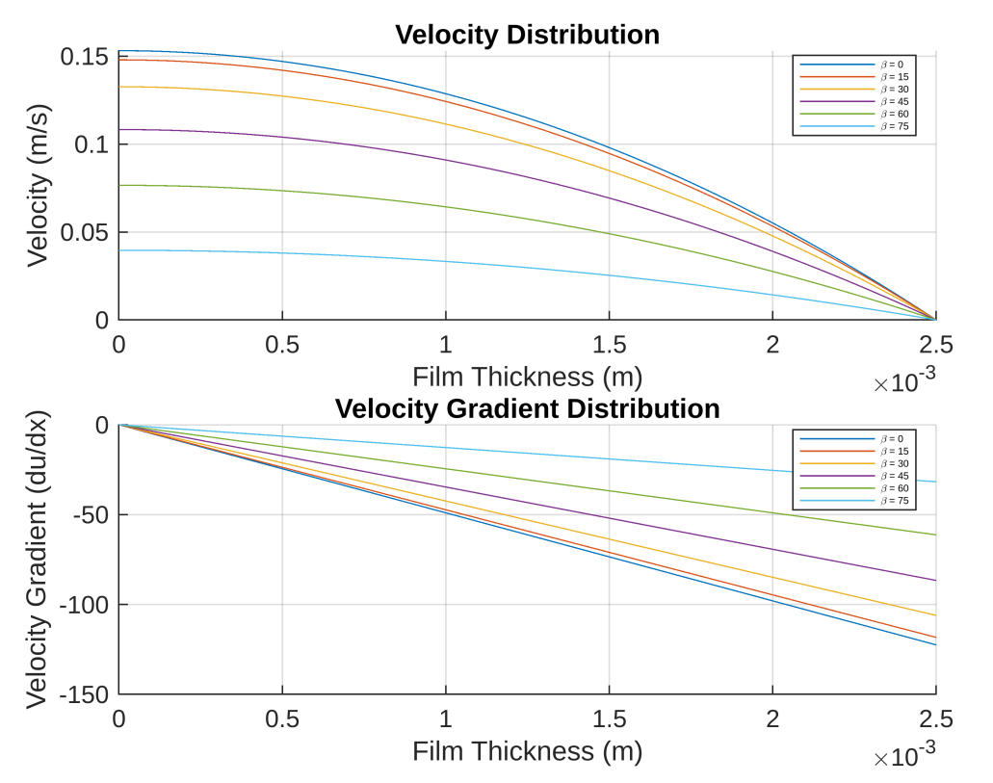
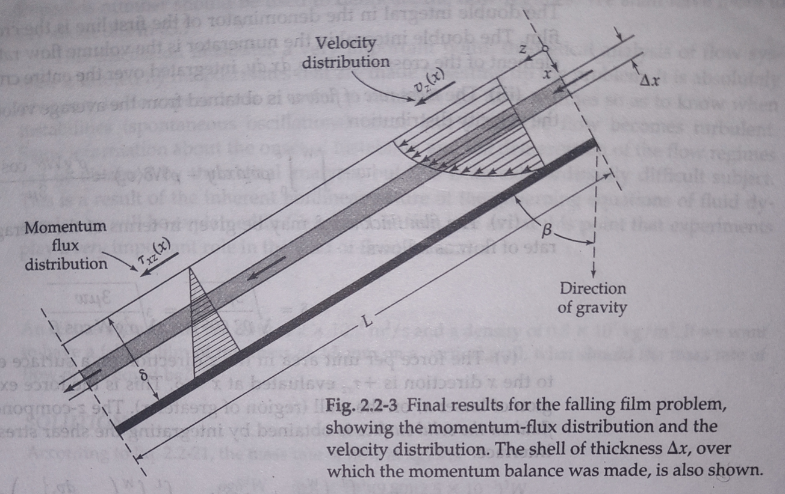
Velocity Distribution due to Variation in Geometry
Ref:- Transport Phenomena(R.Byron Bird, Warren E. Stewart, Edwin N. Lightfoot)
7

Slide 8
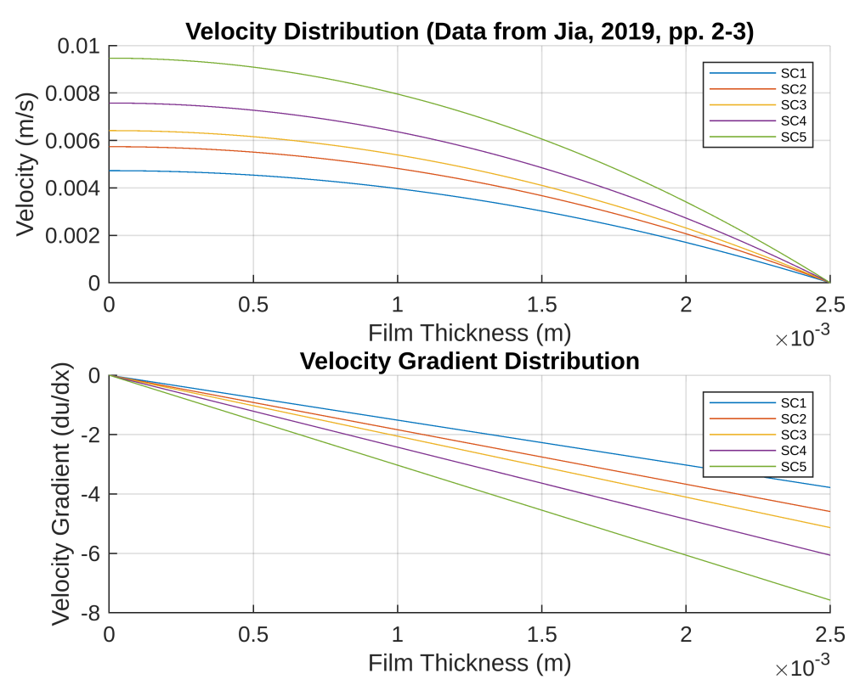
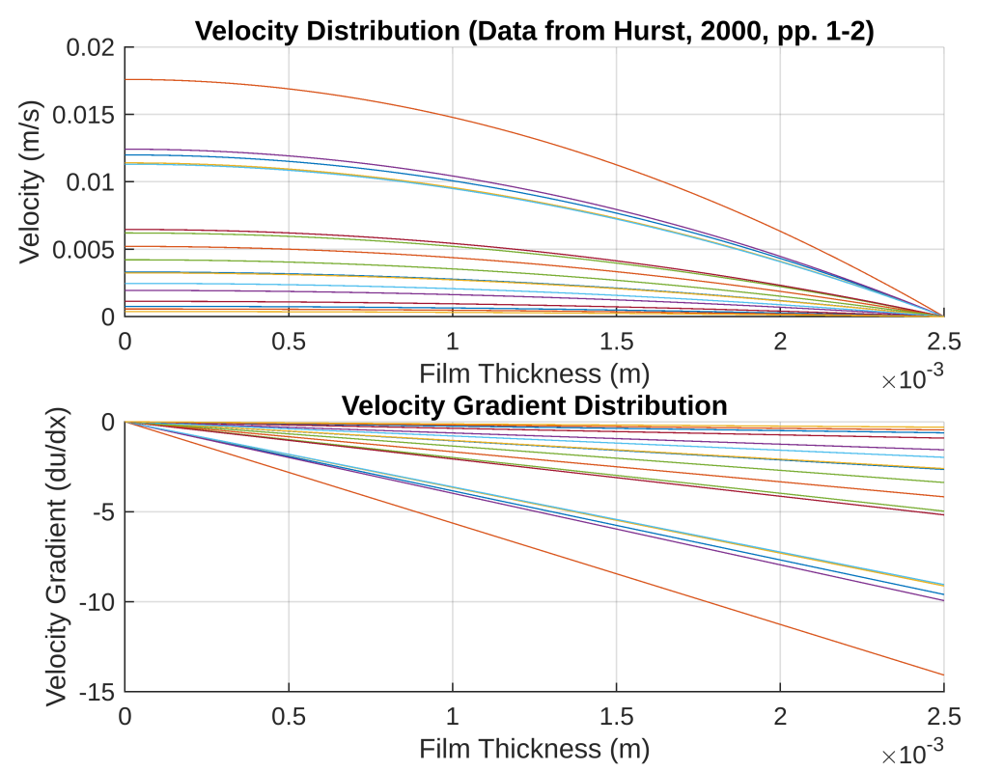
Velocity Distribution due to Variation in Viscosity
8

Slide 9
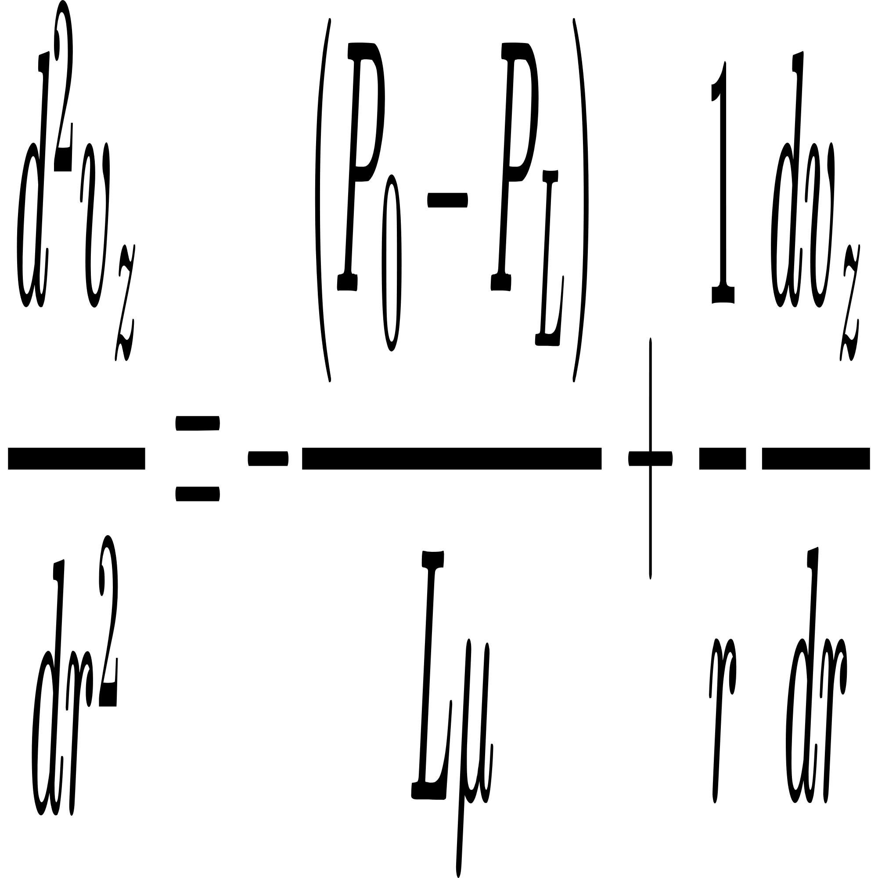
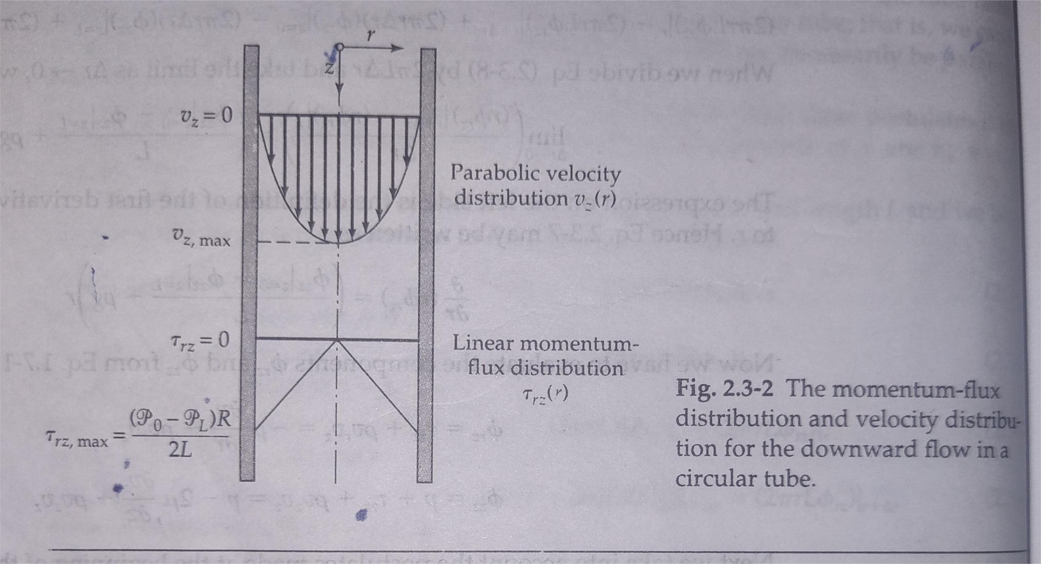
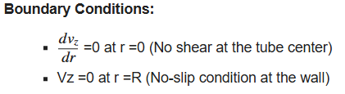
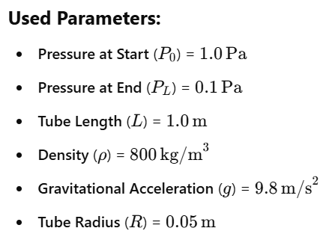
2. Circular Tube
Second-order differential equation:
After Applying Shell Momentum Balance to Steady Flow
Ref:- Transport Phenomena(R.Byron Bird, Warren E. Stewart, Edwin N. Lightfoot)
9

Slide 10
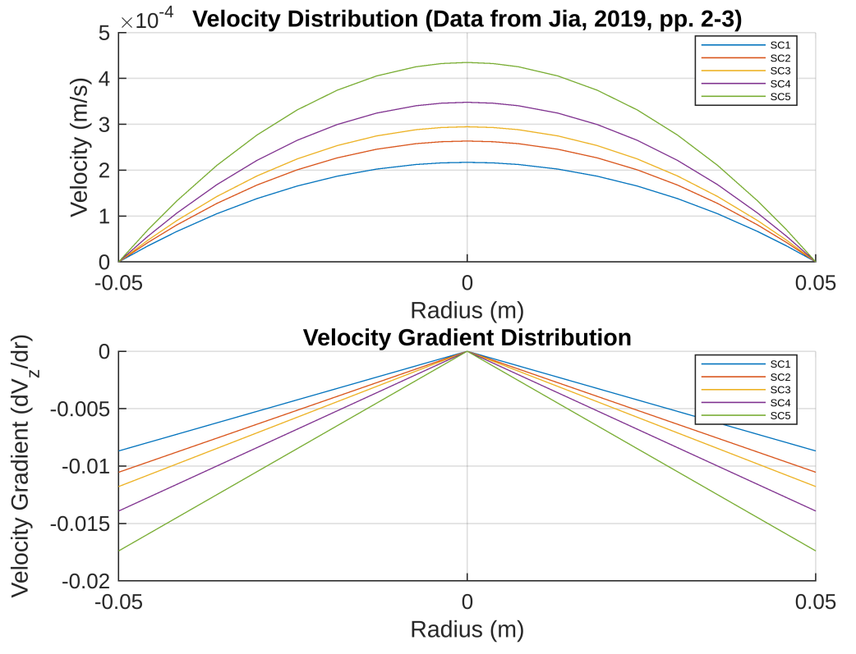
Velocity Distribution due to Variation in Viscosity
10

Slide 11
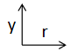
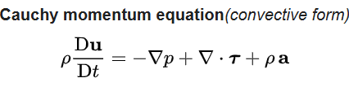
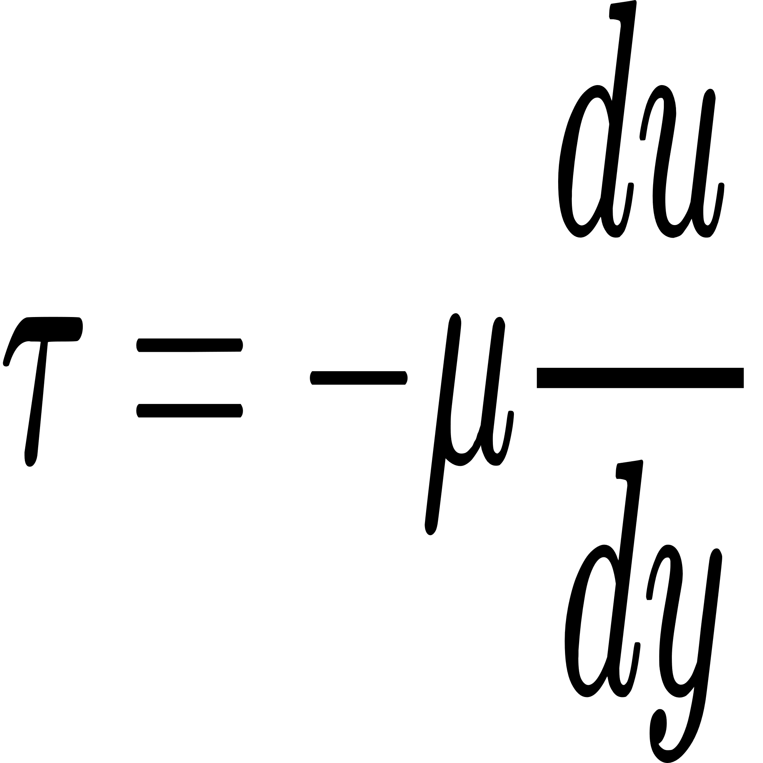
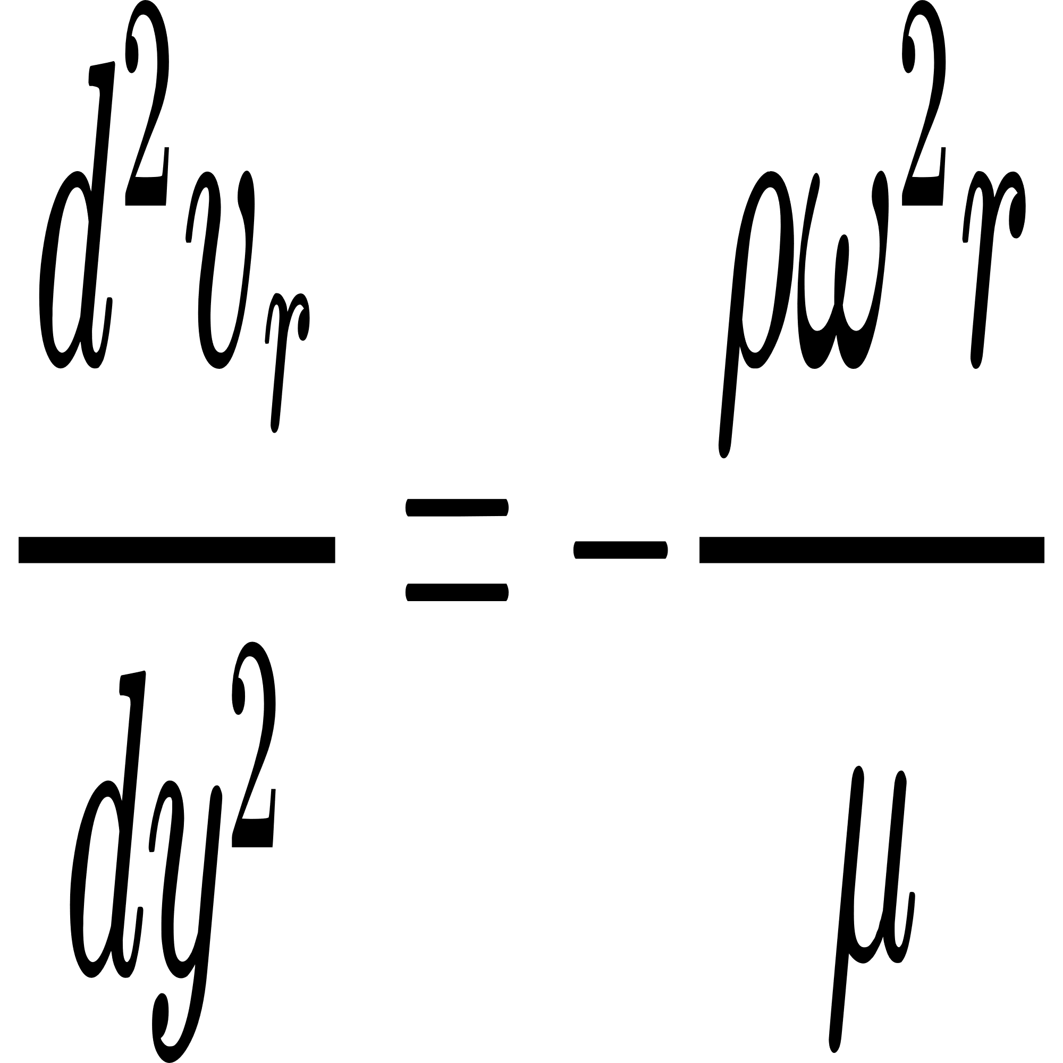
3. Rotating Disk
Navier–Stokes equations:
Very thin (δ) layer of slag
ω
Steady flow
(Newton's law of viscosity)
Disk
a = ω²r
ω
Centrifugal Force per Unit Volume
Final Form of the Navier-Stokes Equation for a Rotating Disk :-
r
ρω²r
Disk
11
8

Slide 12
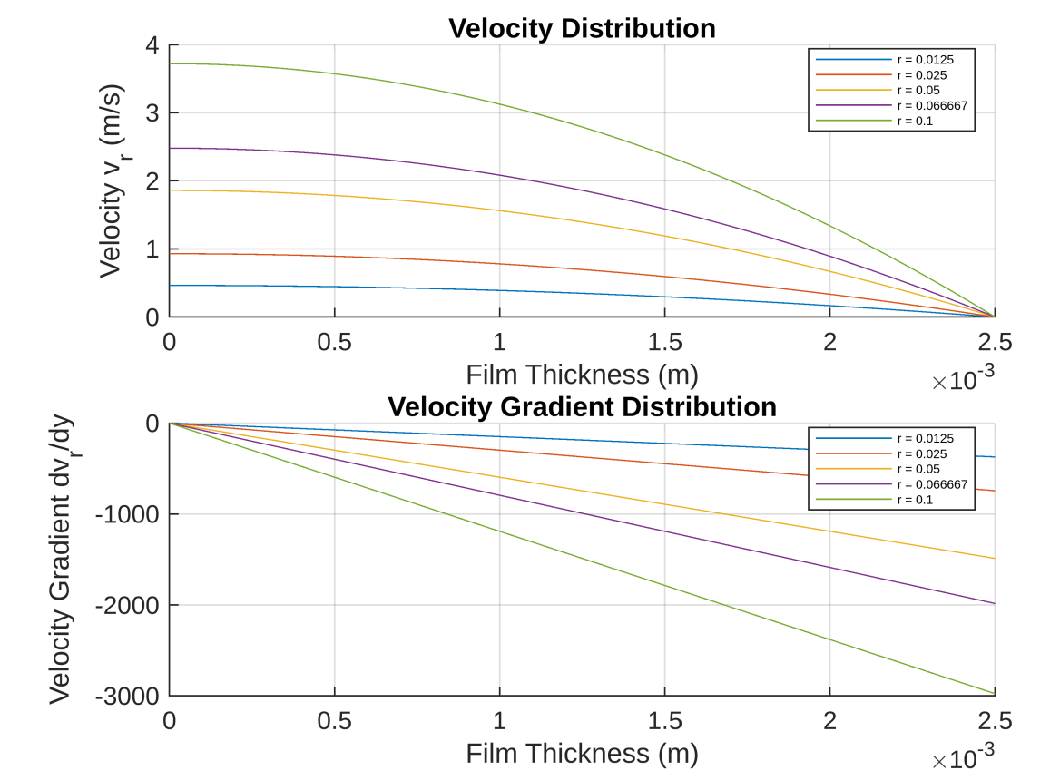
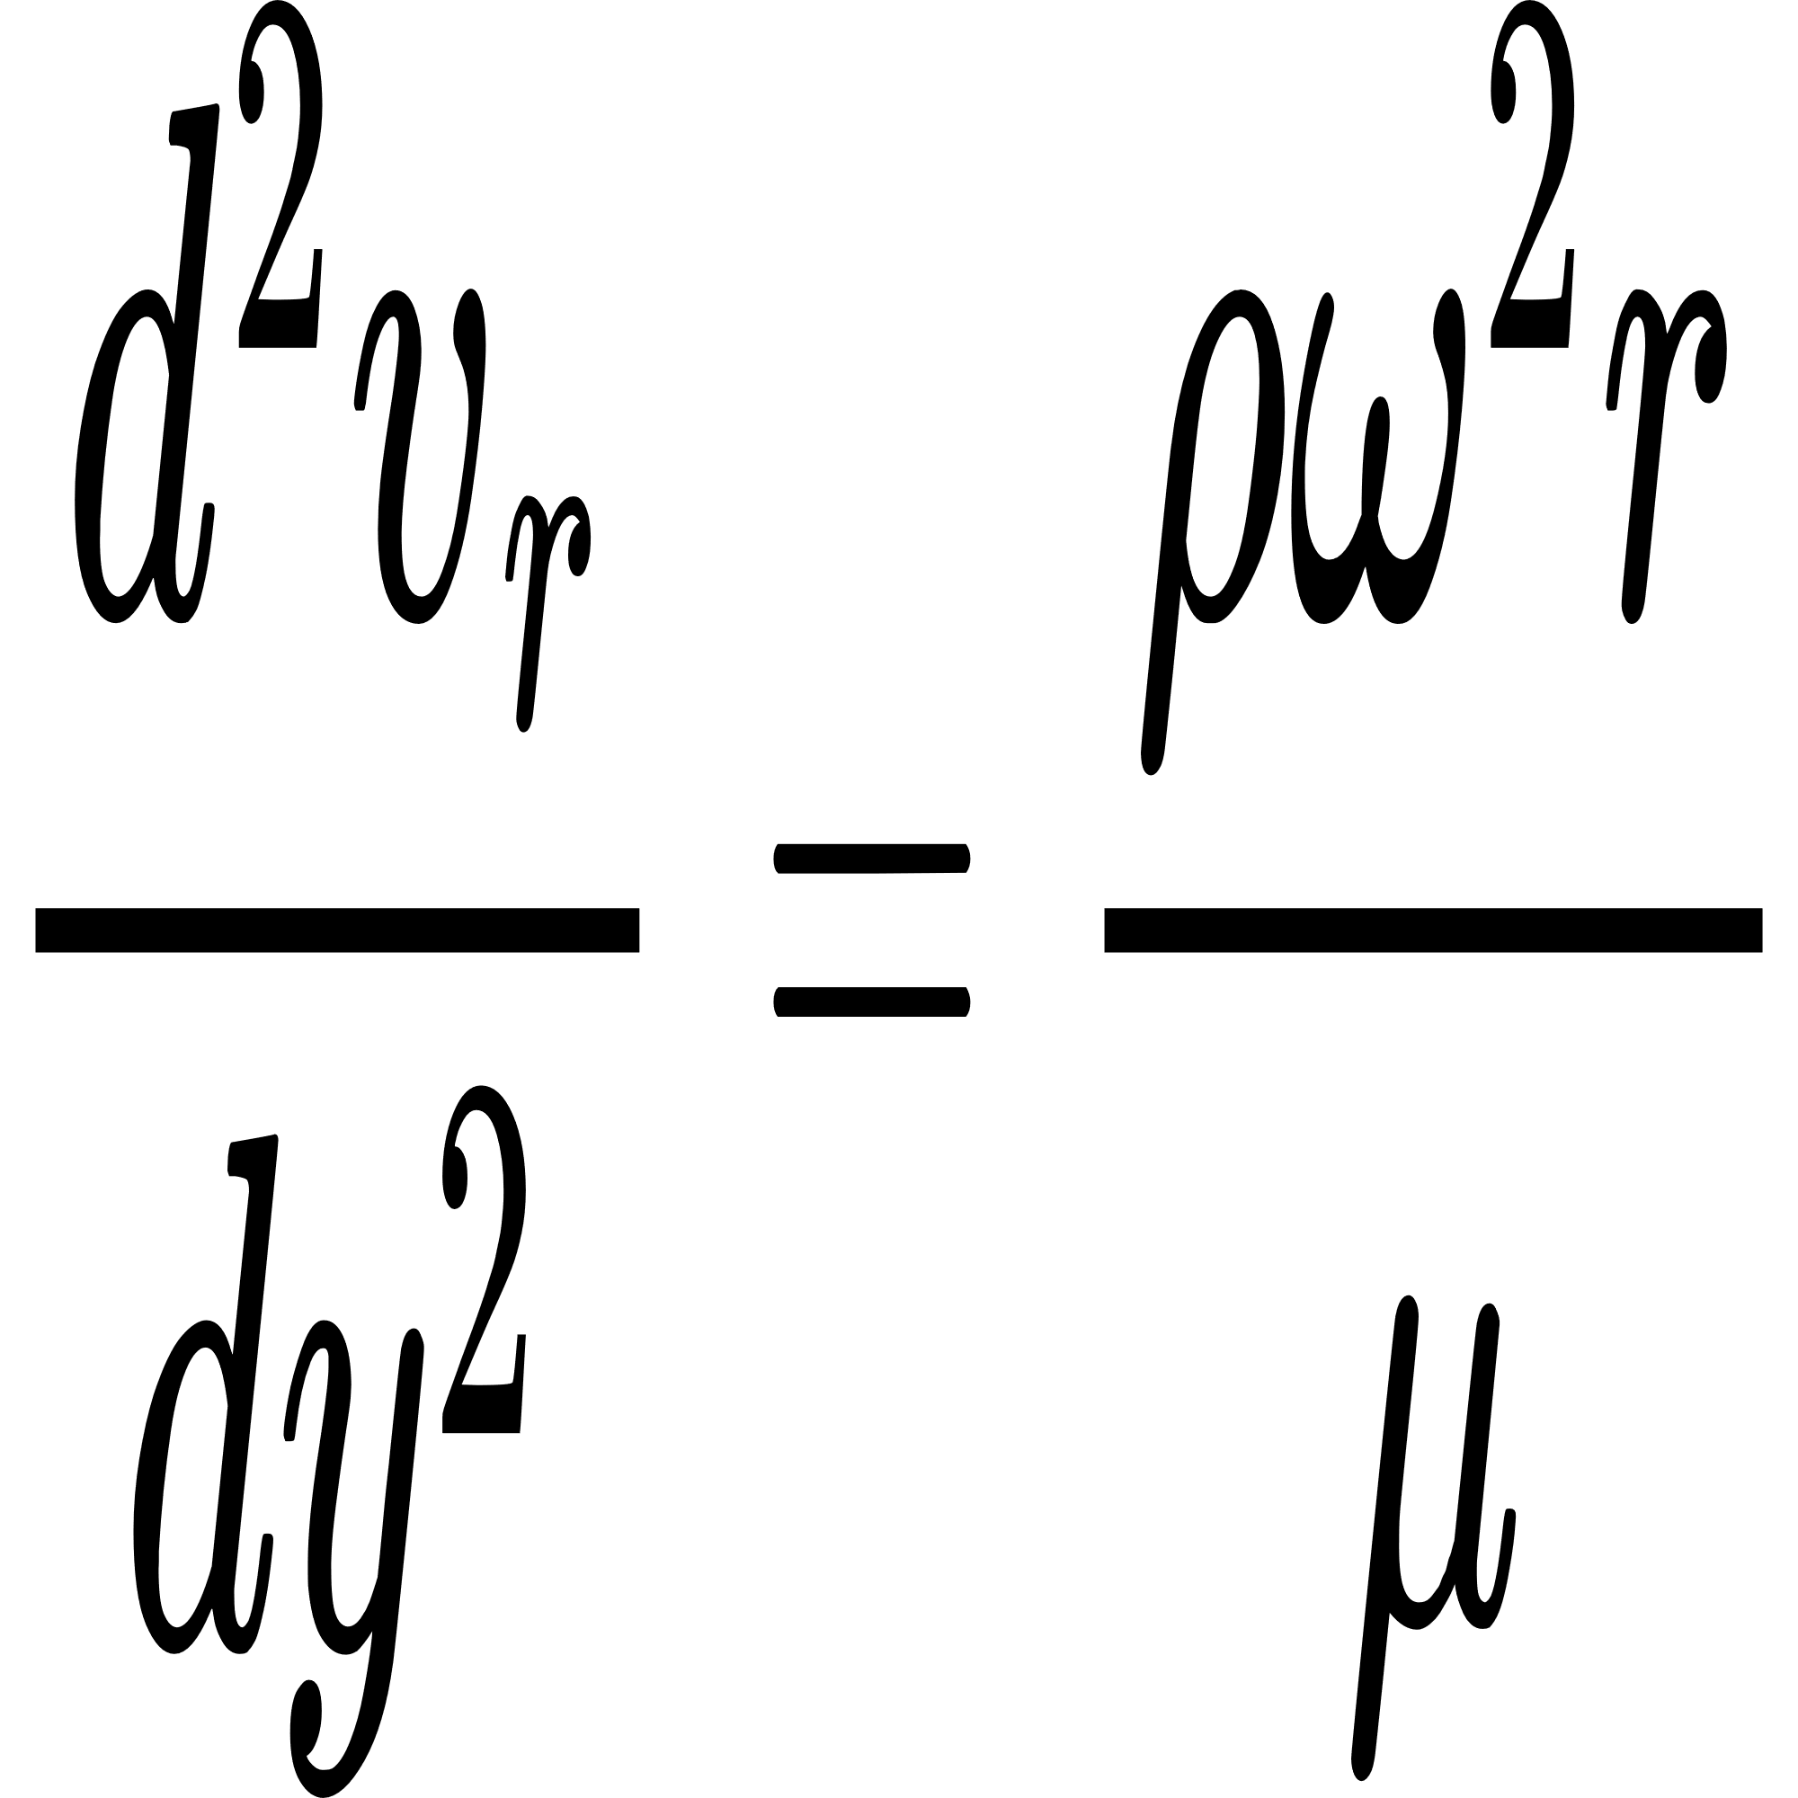
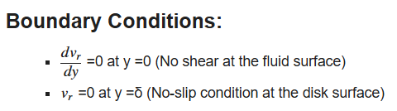
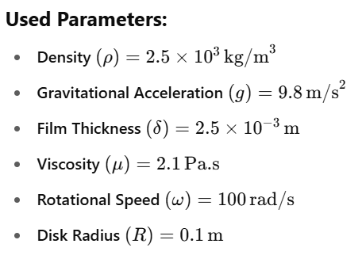
Velocity Distribution due to Radial Variation
Second-order differential equation:
12

Slide 13
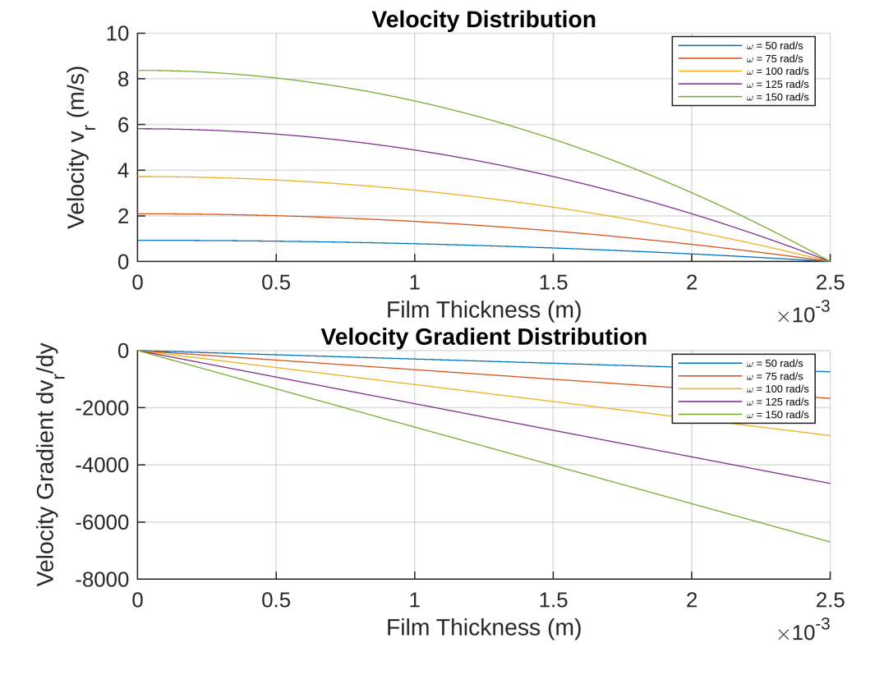
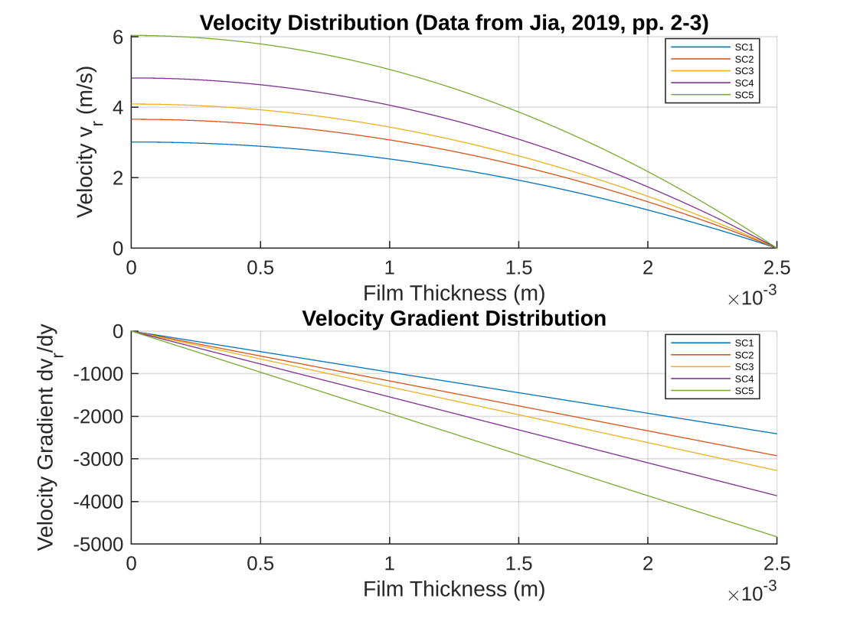
Velocity Distribution for Different Rotational Speeds (ω)
Velocity Distribution due to Variation in Viscosity
13

Slide 14
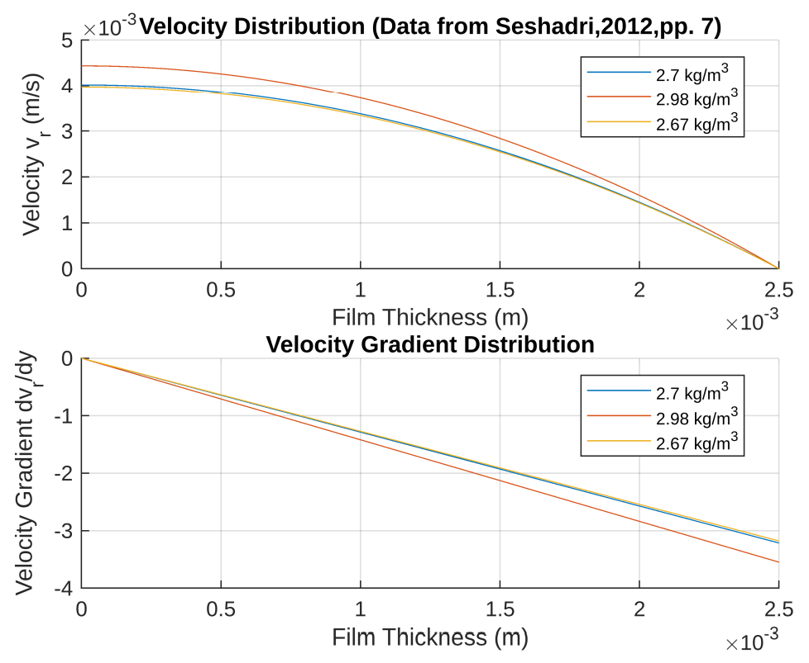
Velocity Distribution due to Variation in Density
14

Slide 15
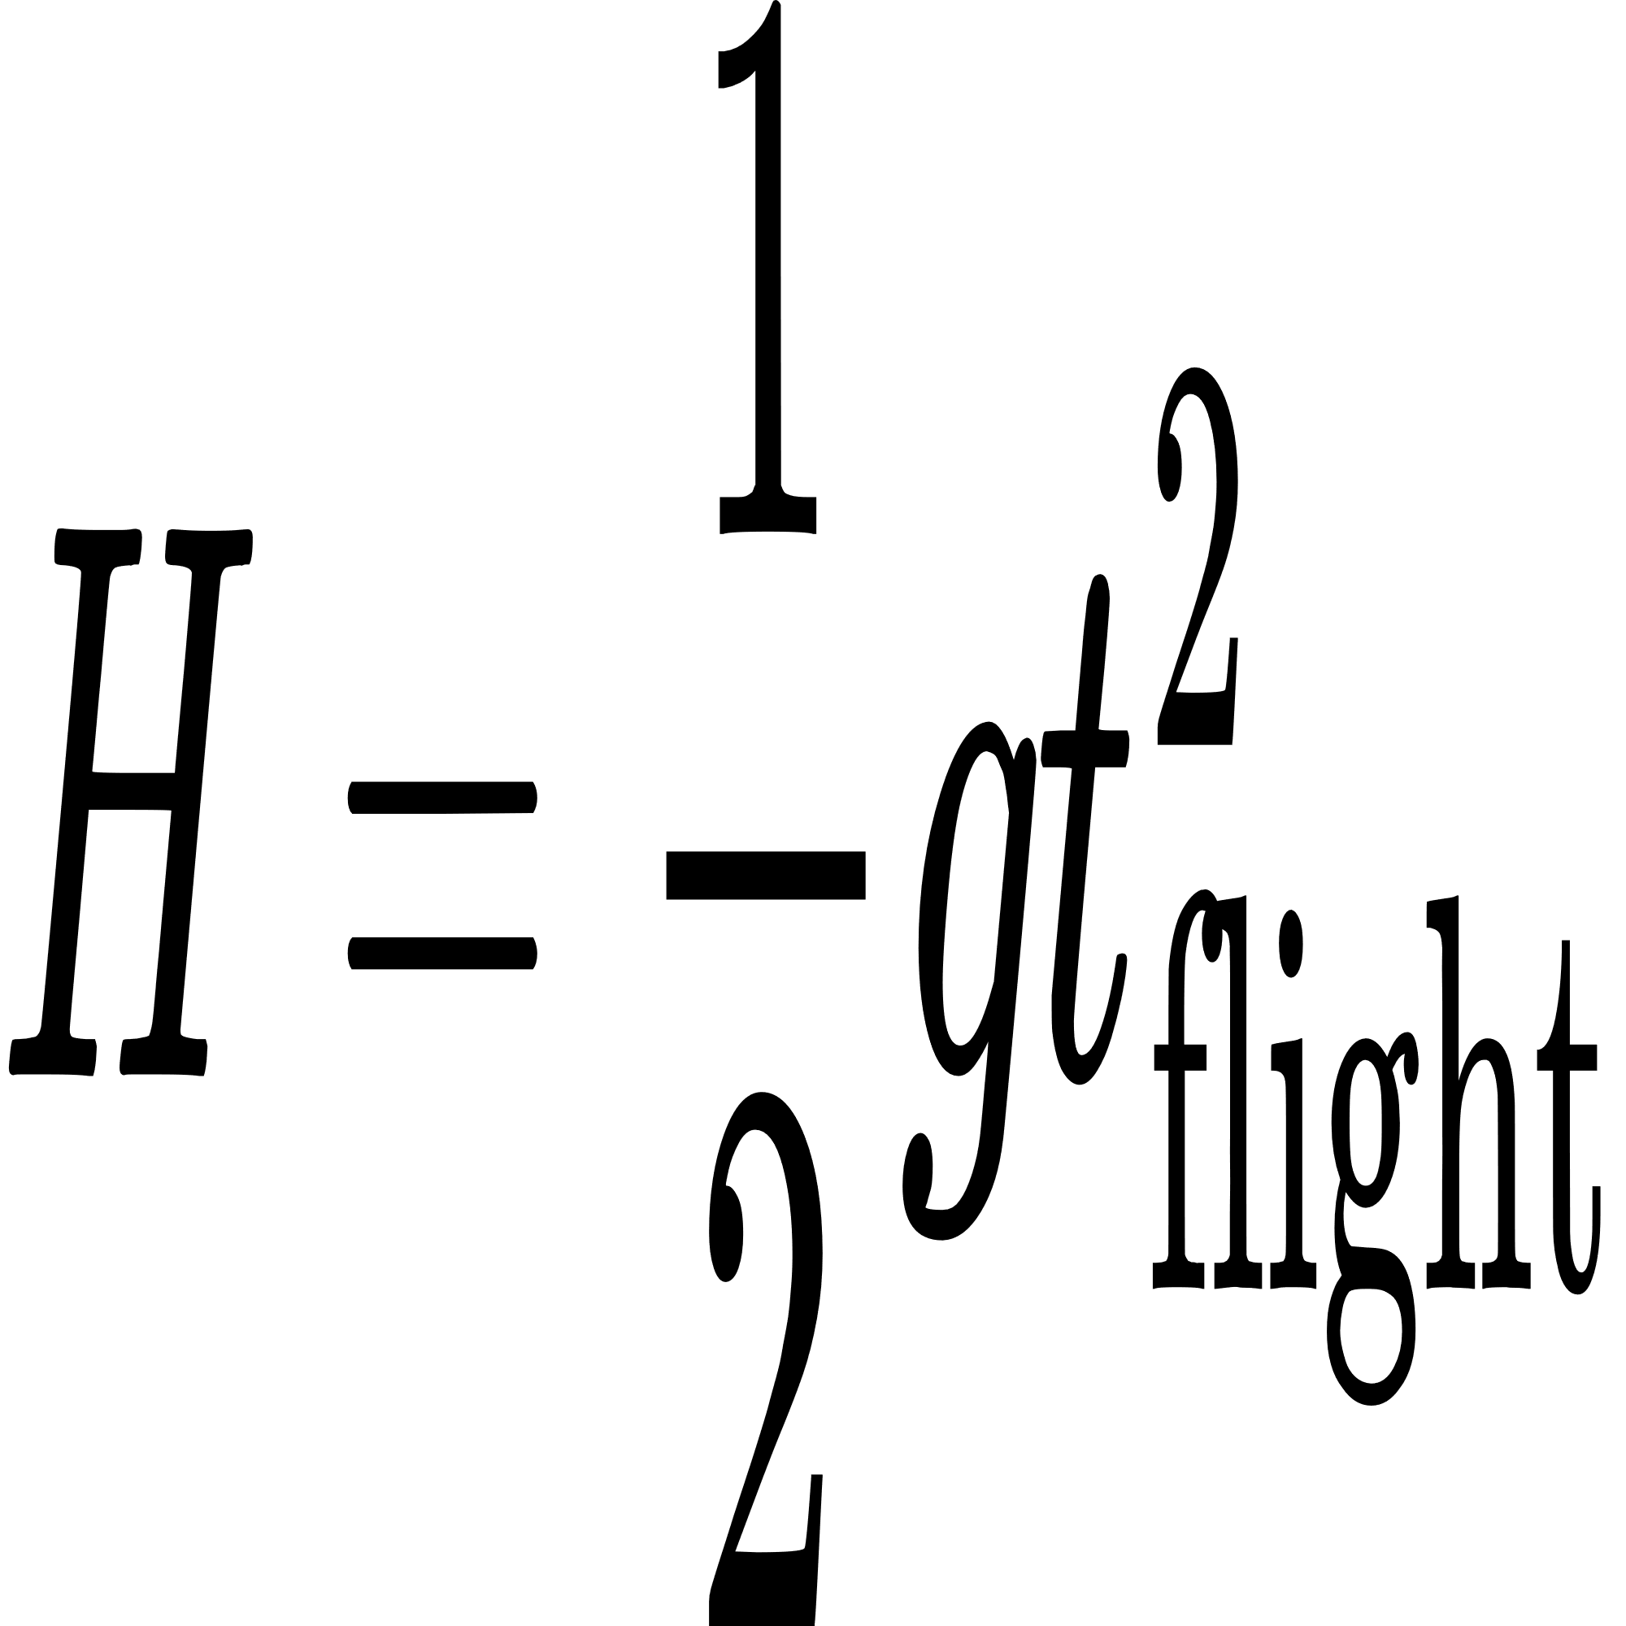
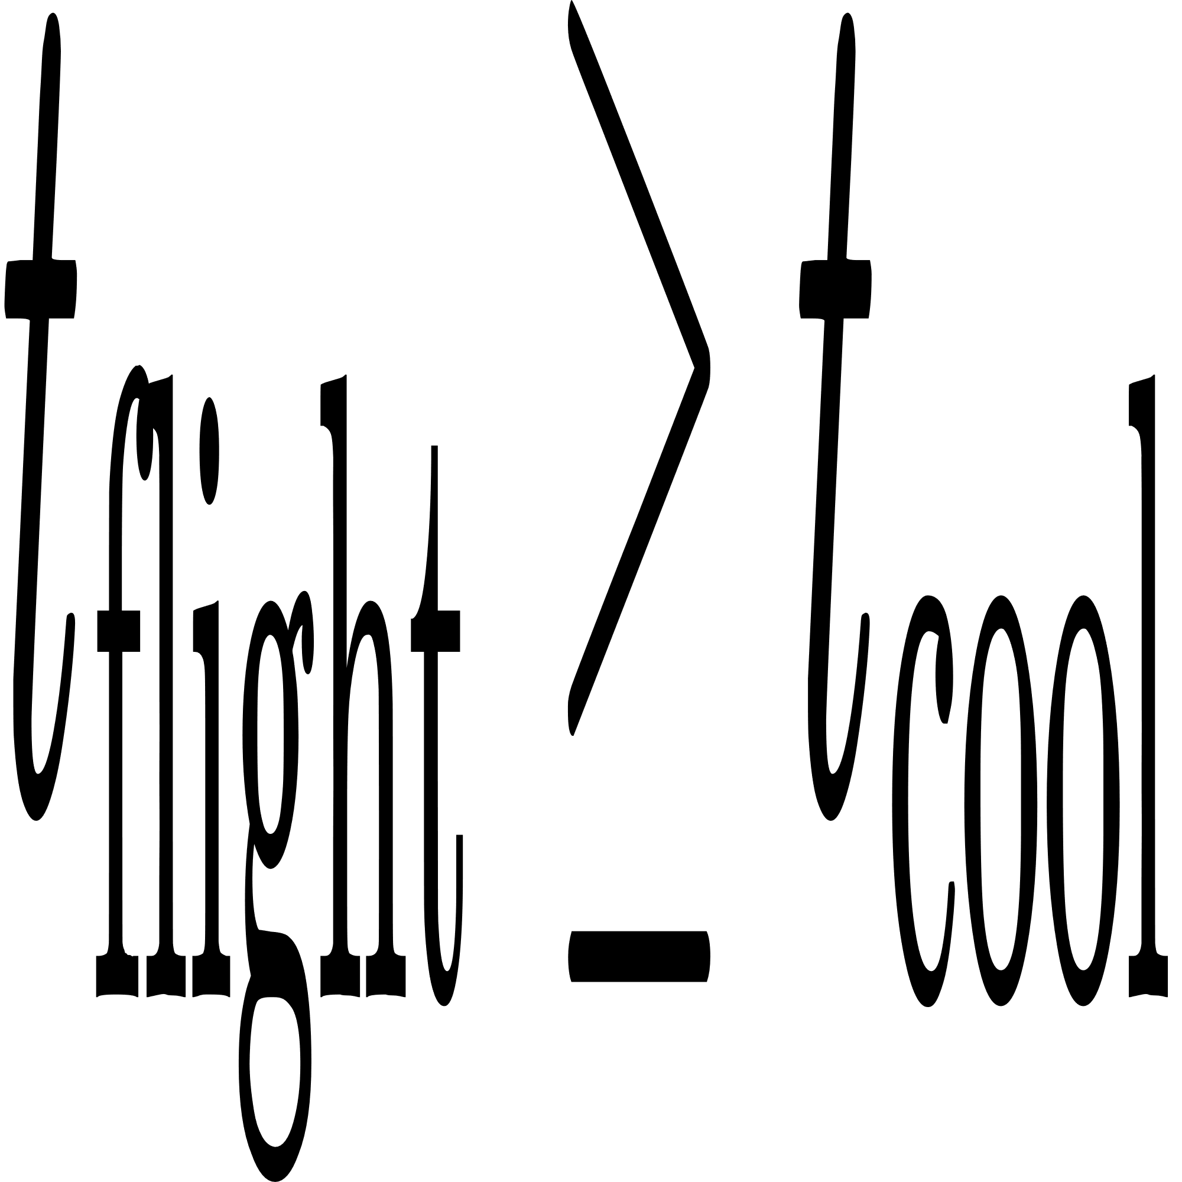
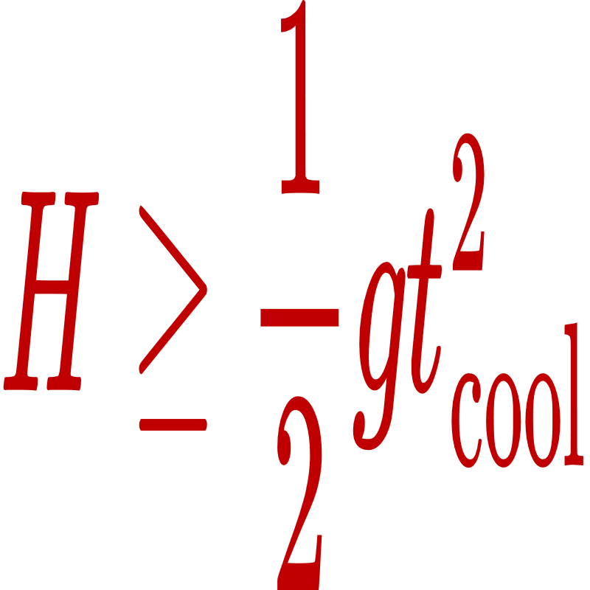
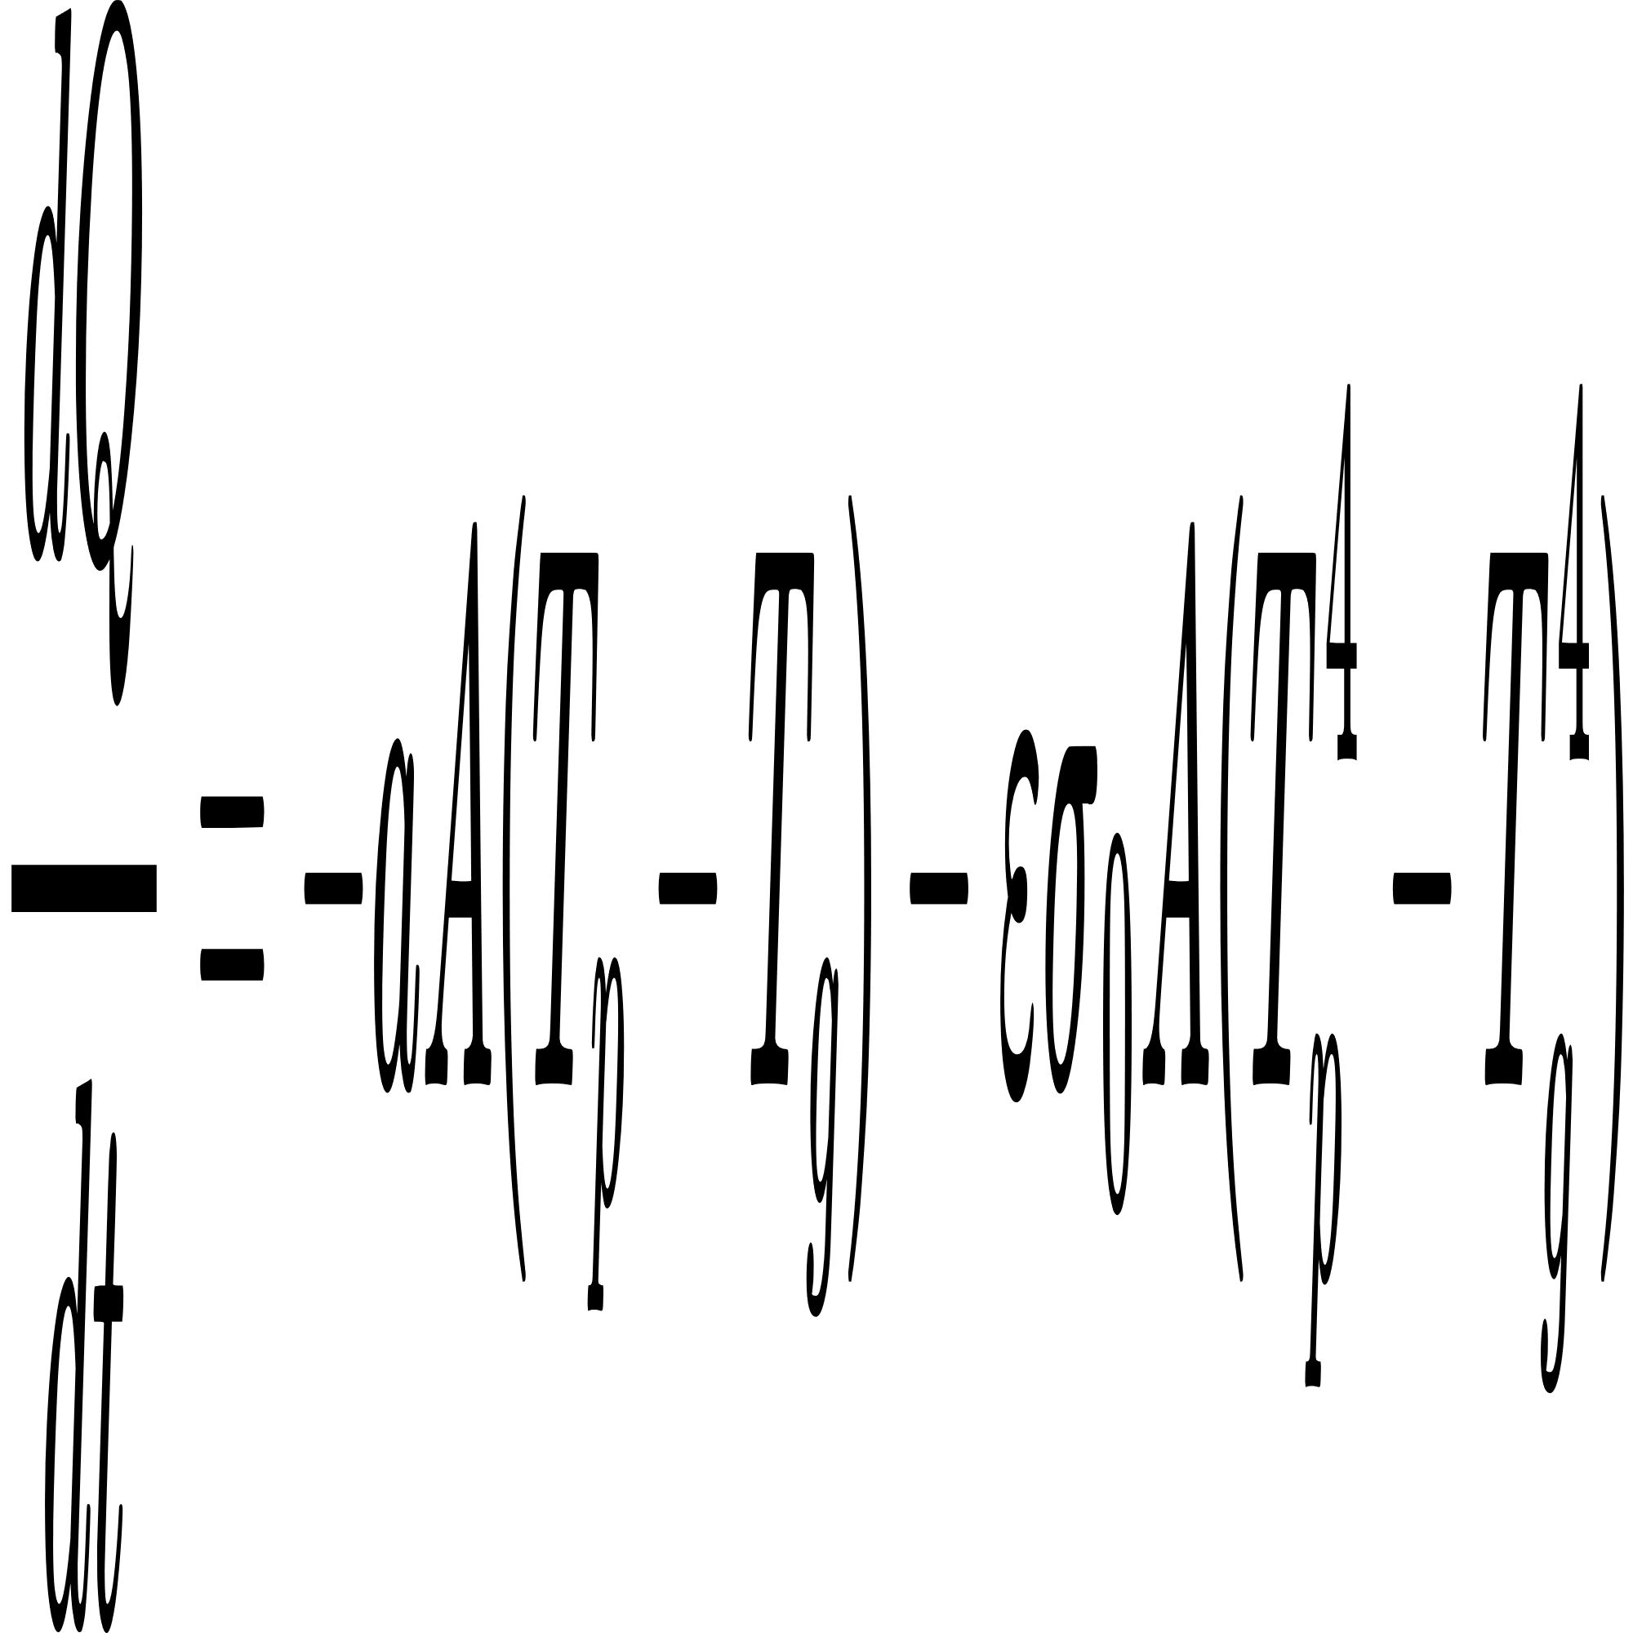
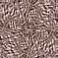
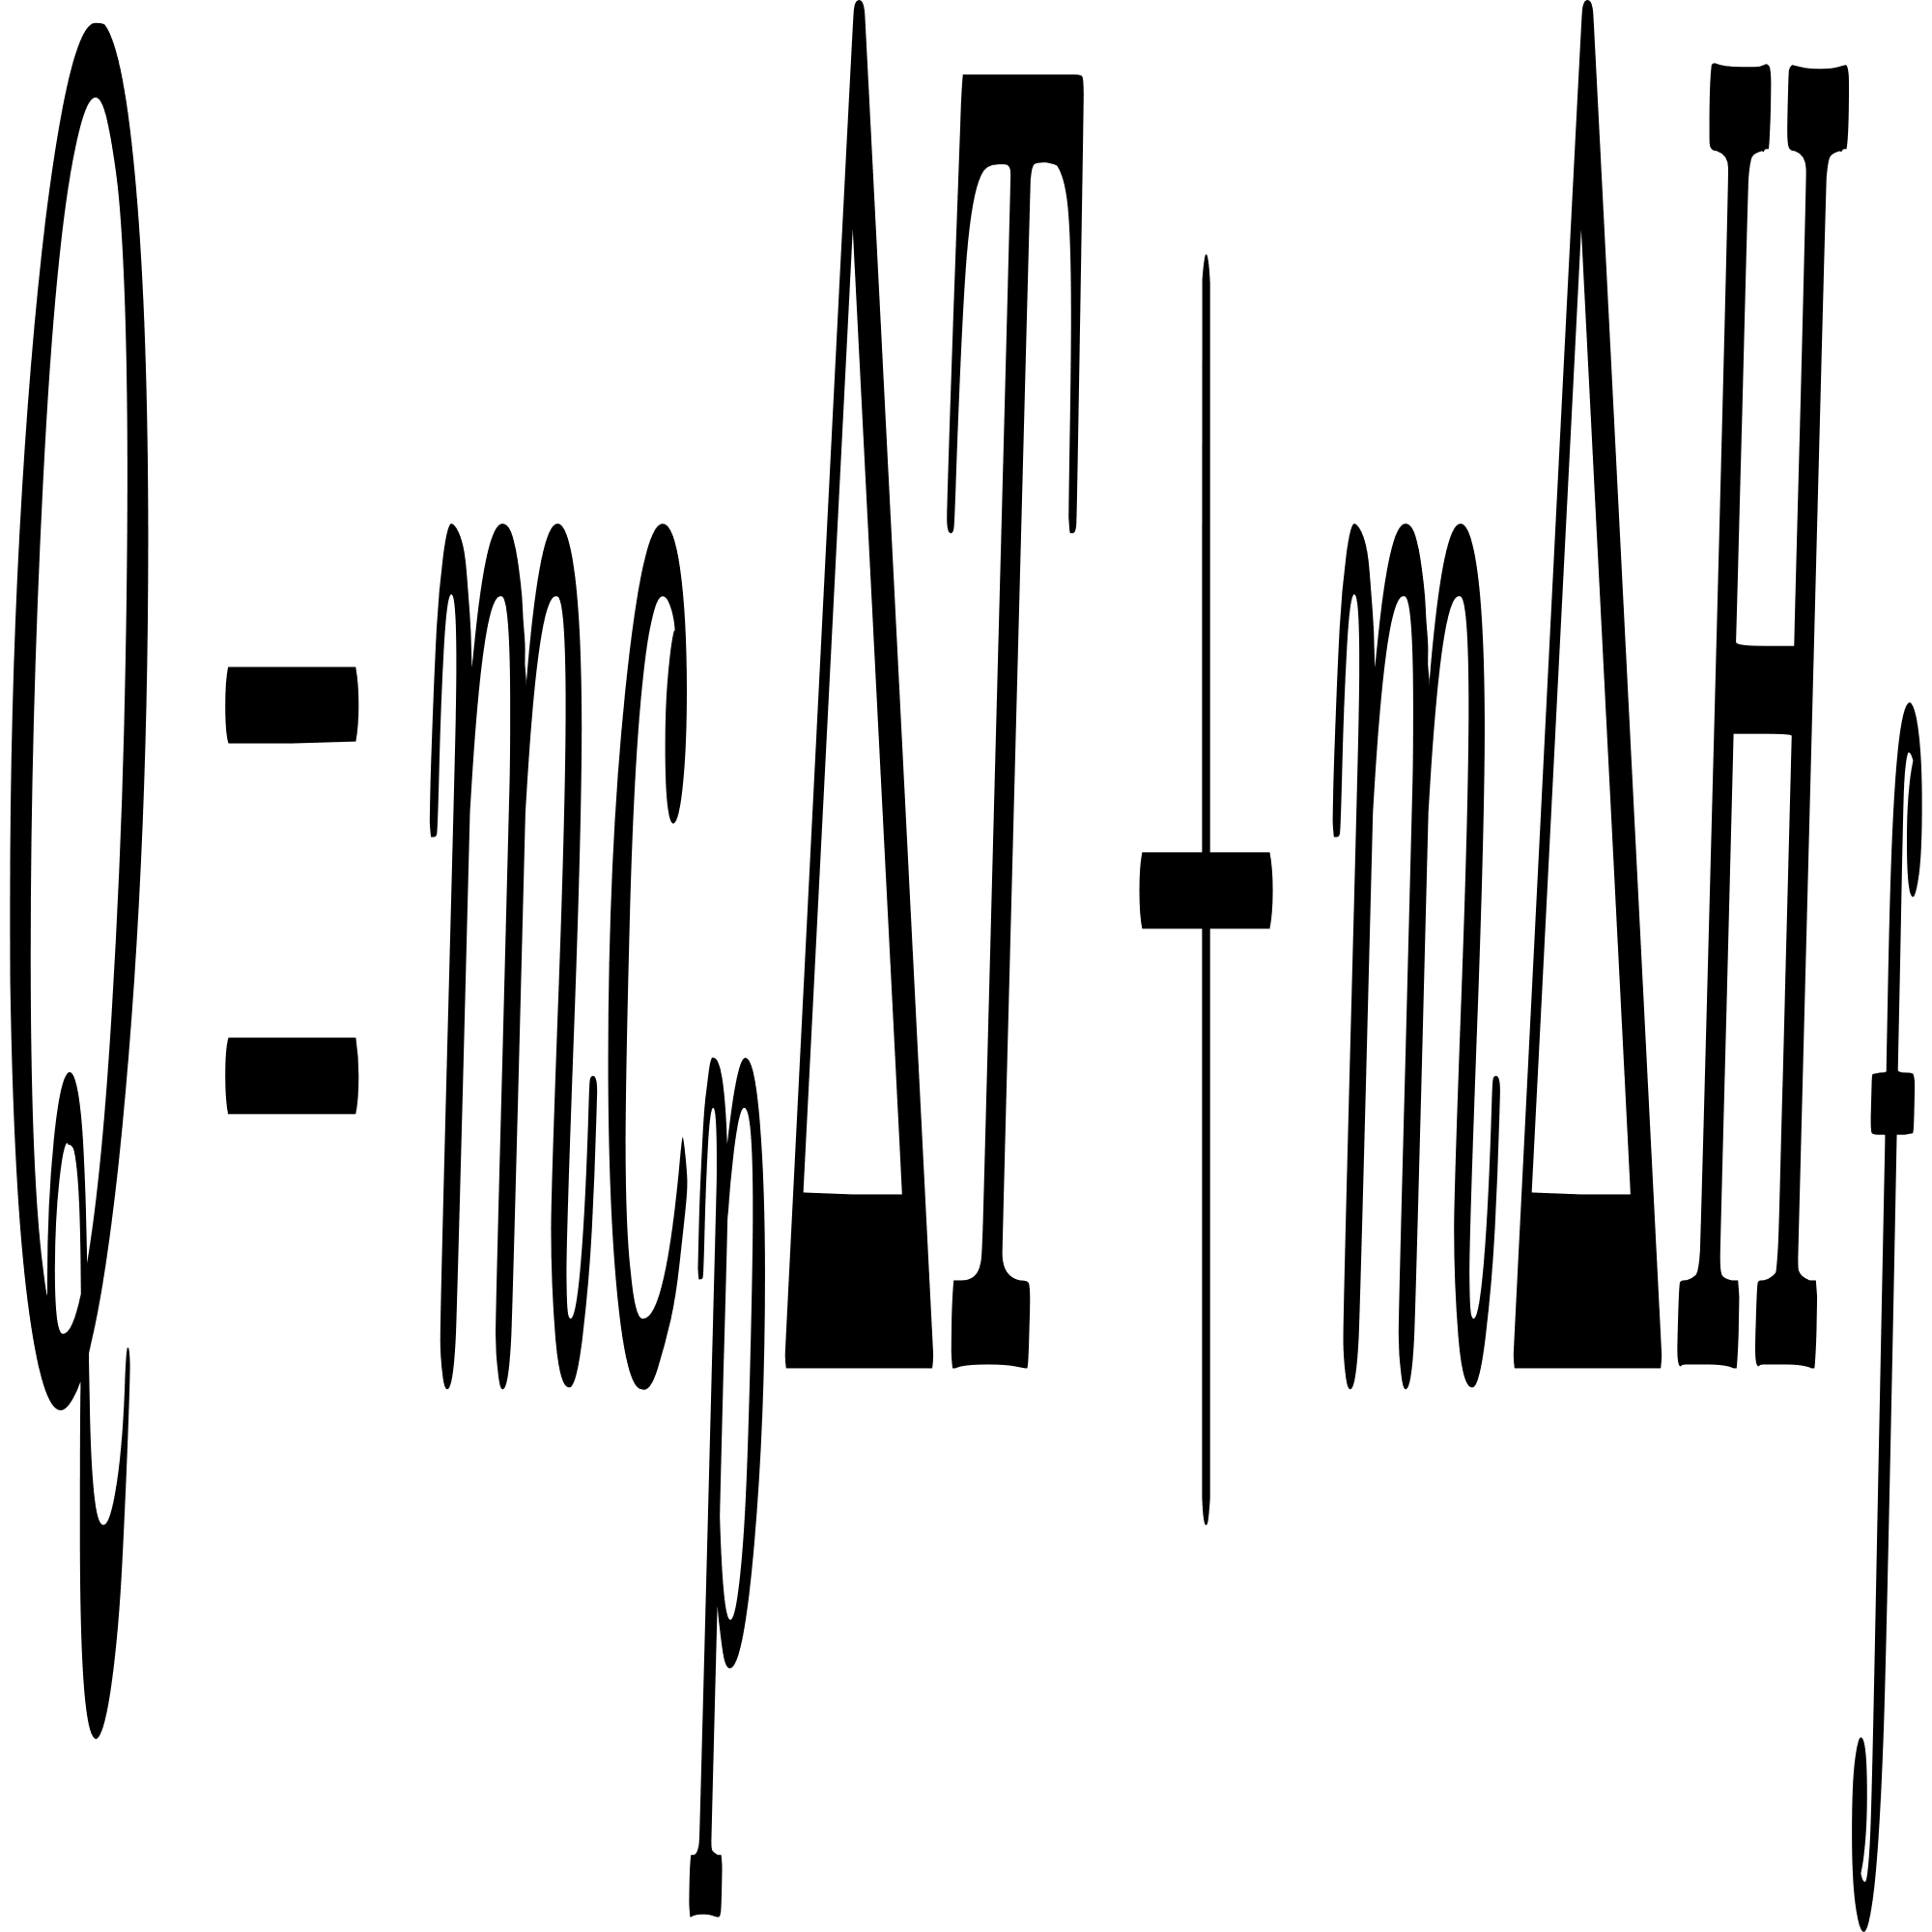
Setup
ω
vertical height of the disc from the ground
Molten slag
Disk
H
According to Newton’s Law of Cooling-
Cooled slag particle
Sensible Heat Latent Heat
15
Notes:
xyz
xyz

Slide 16
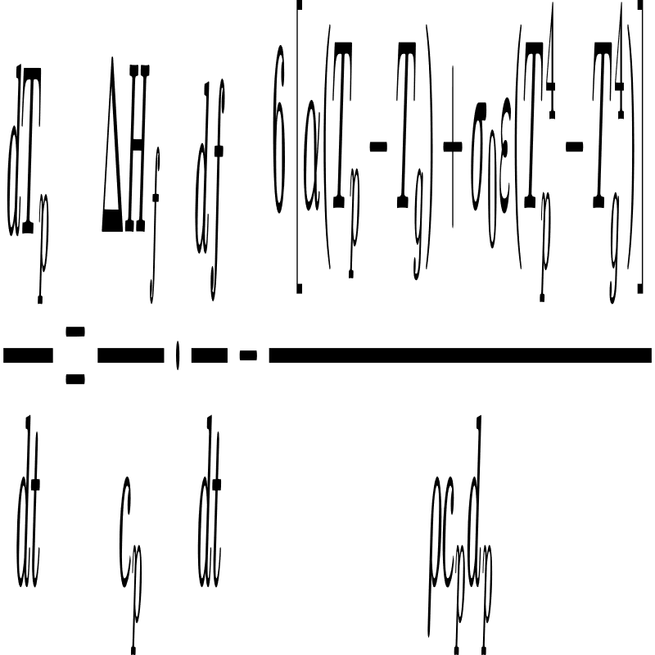
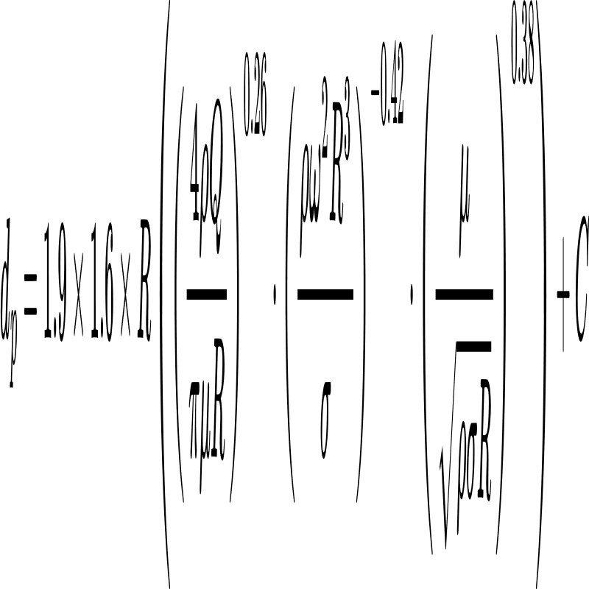
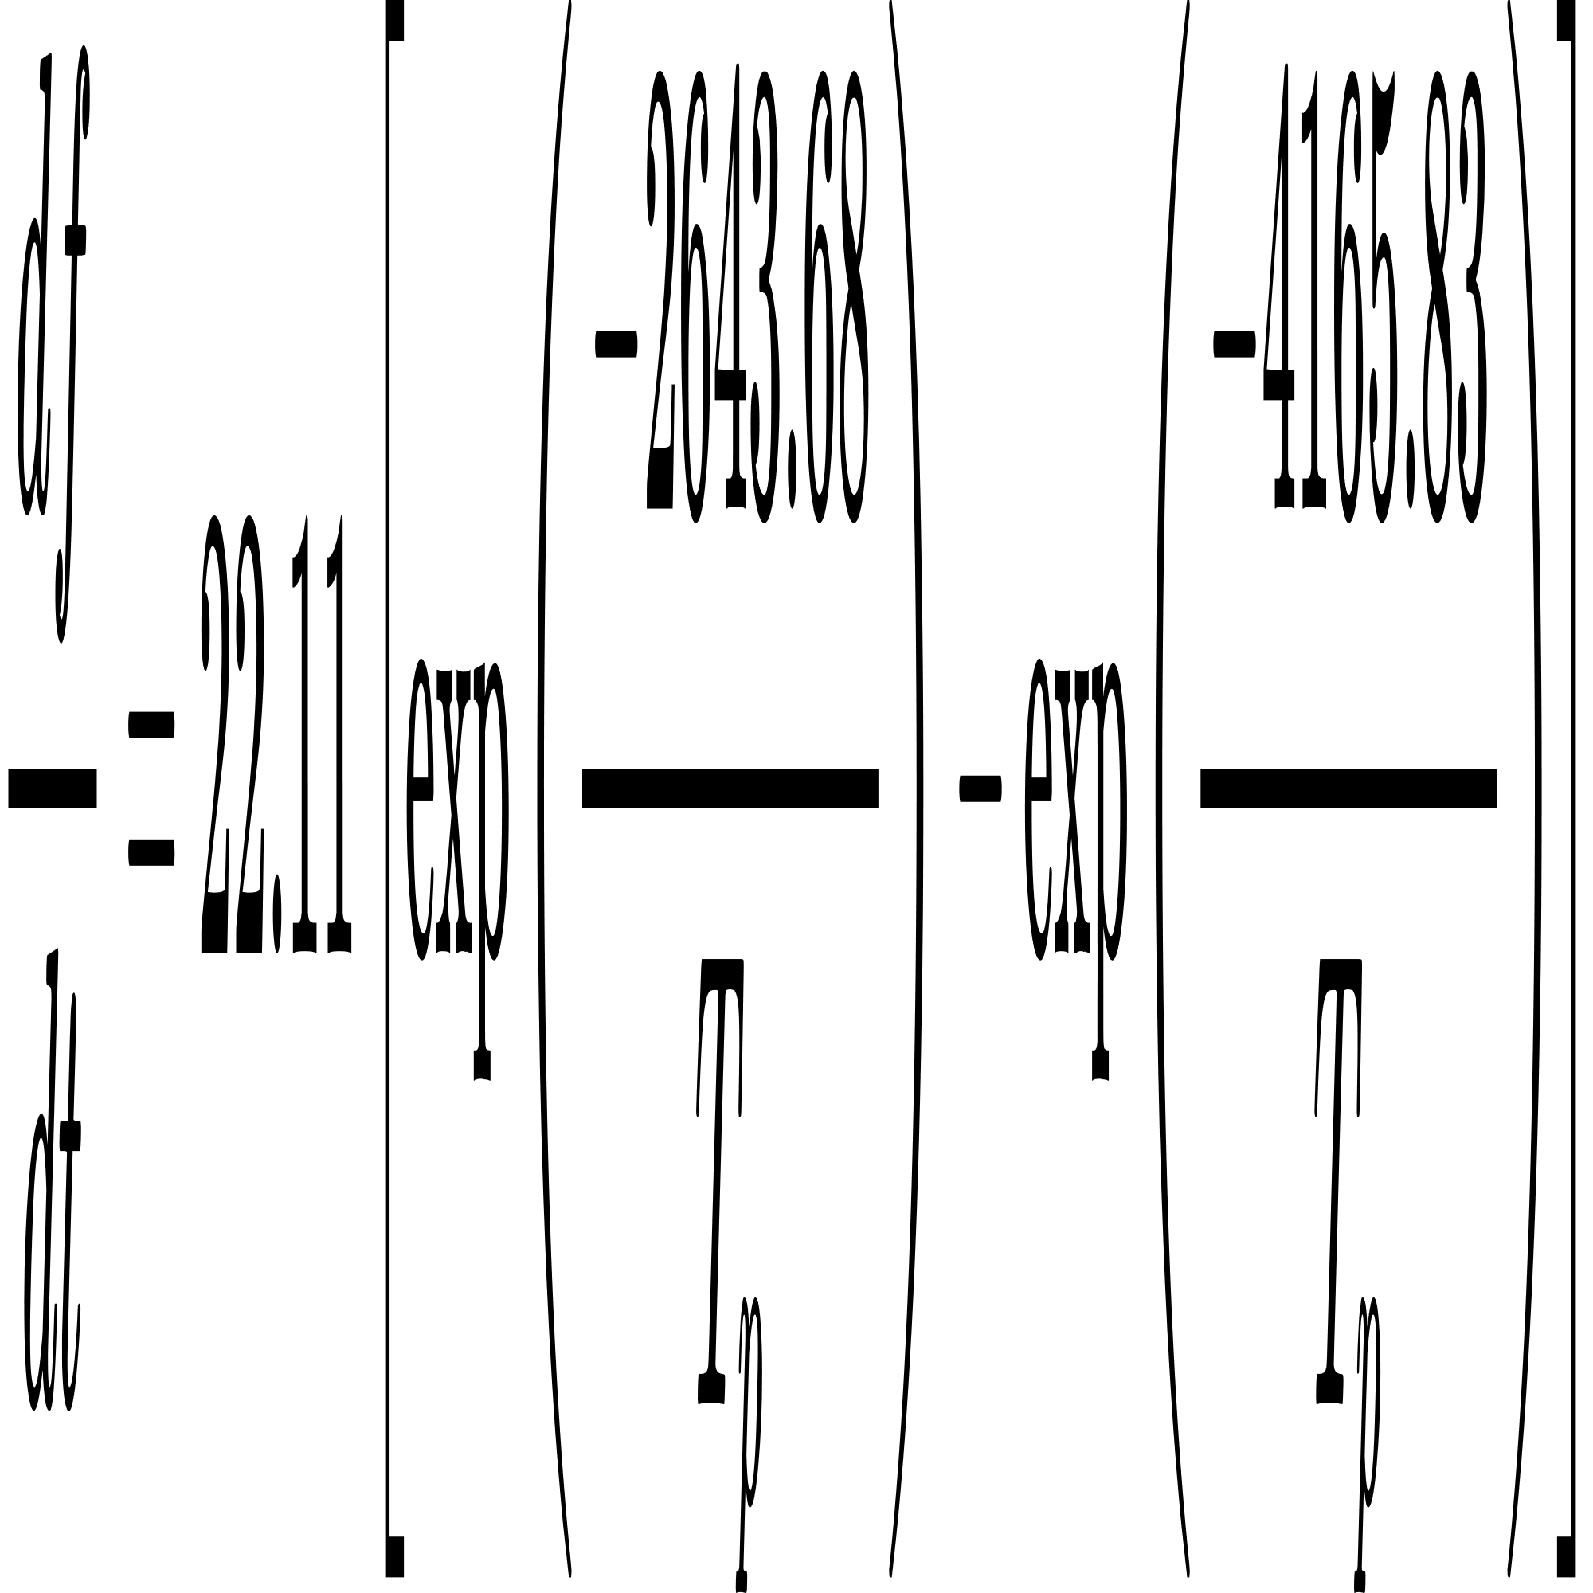
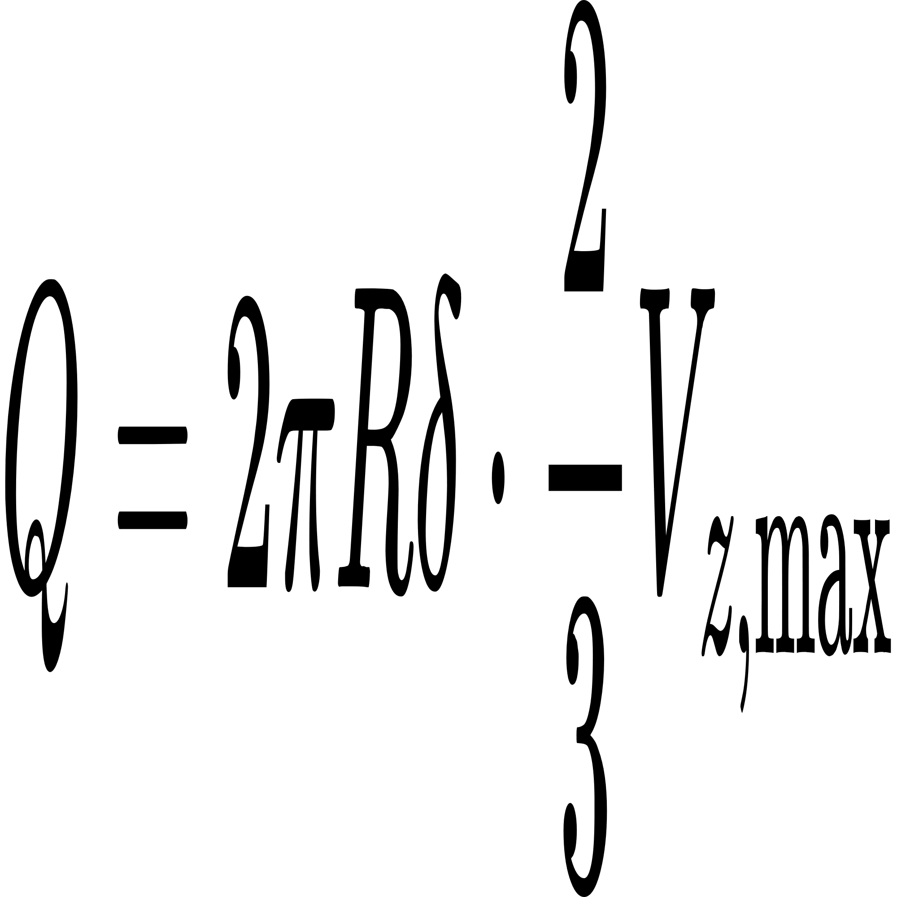
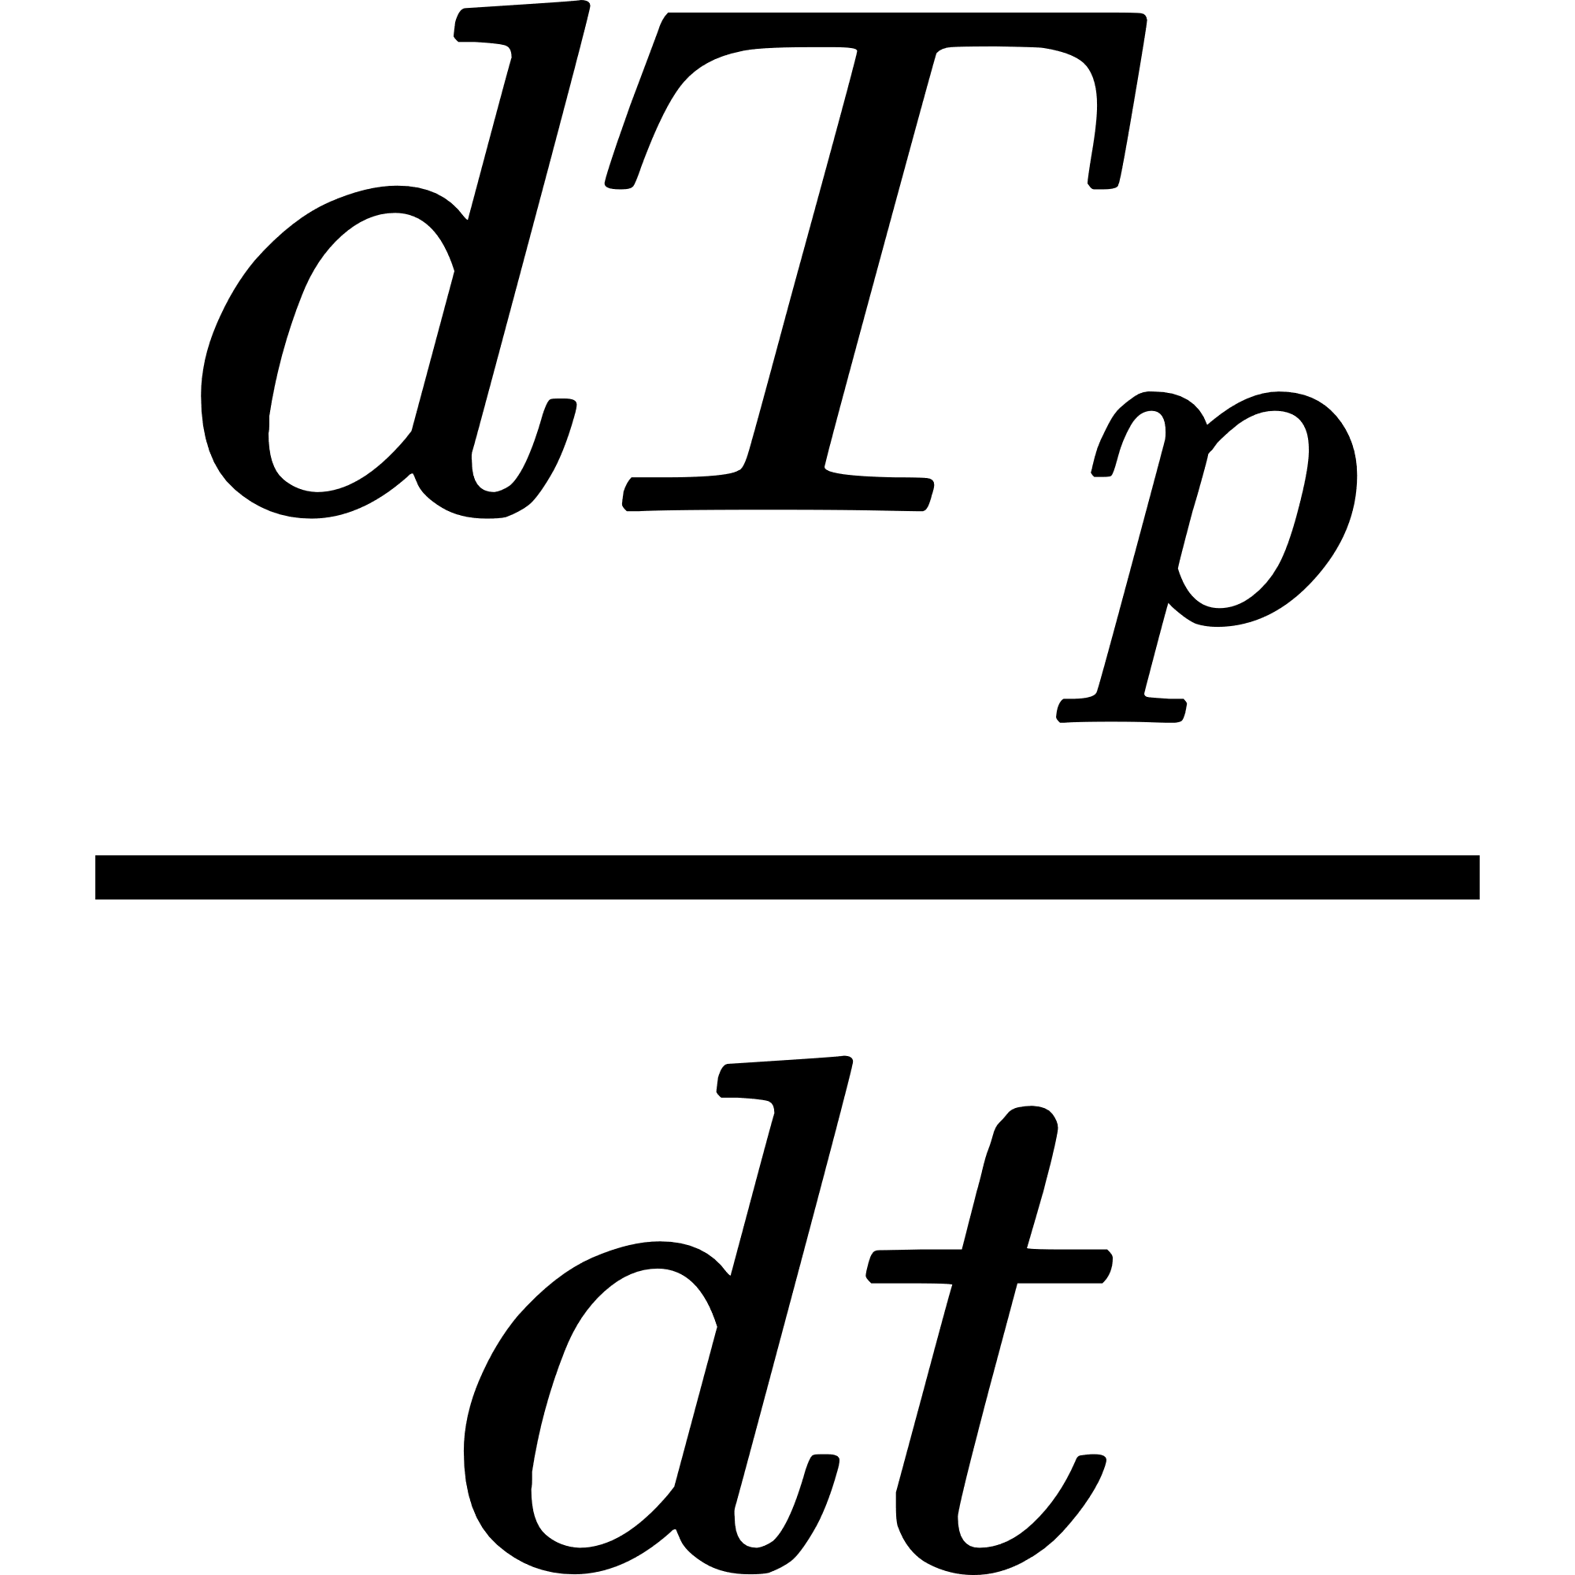
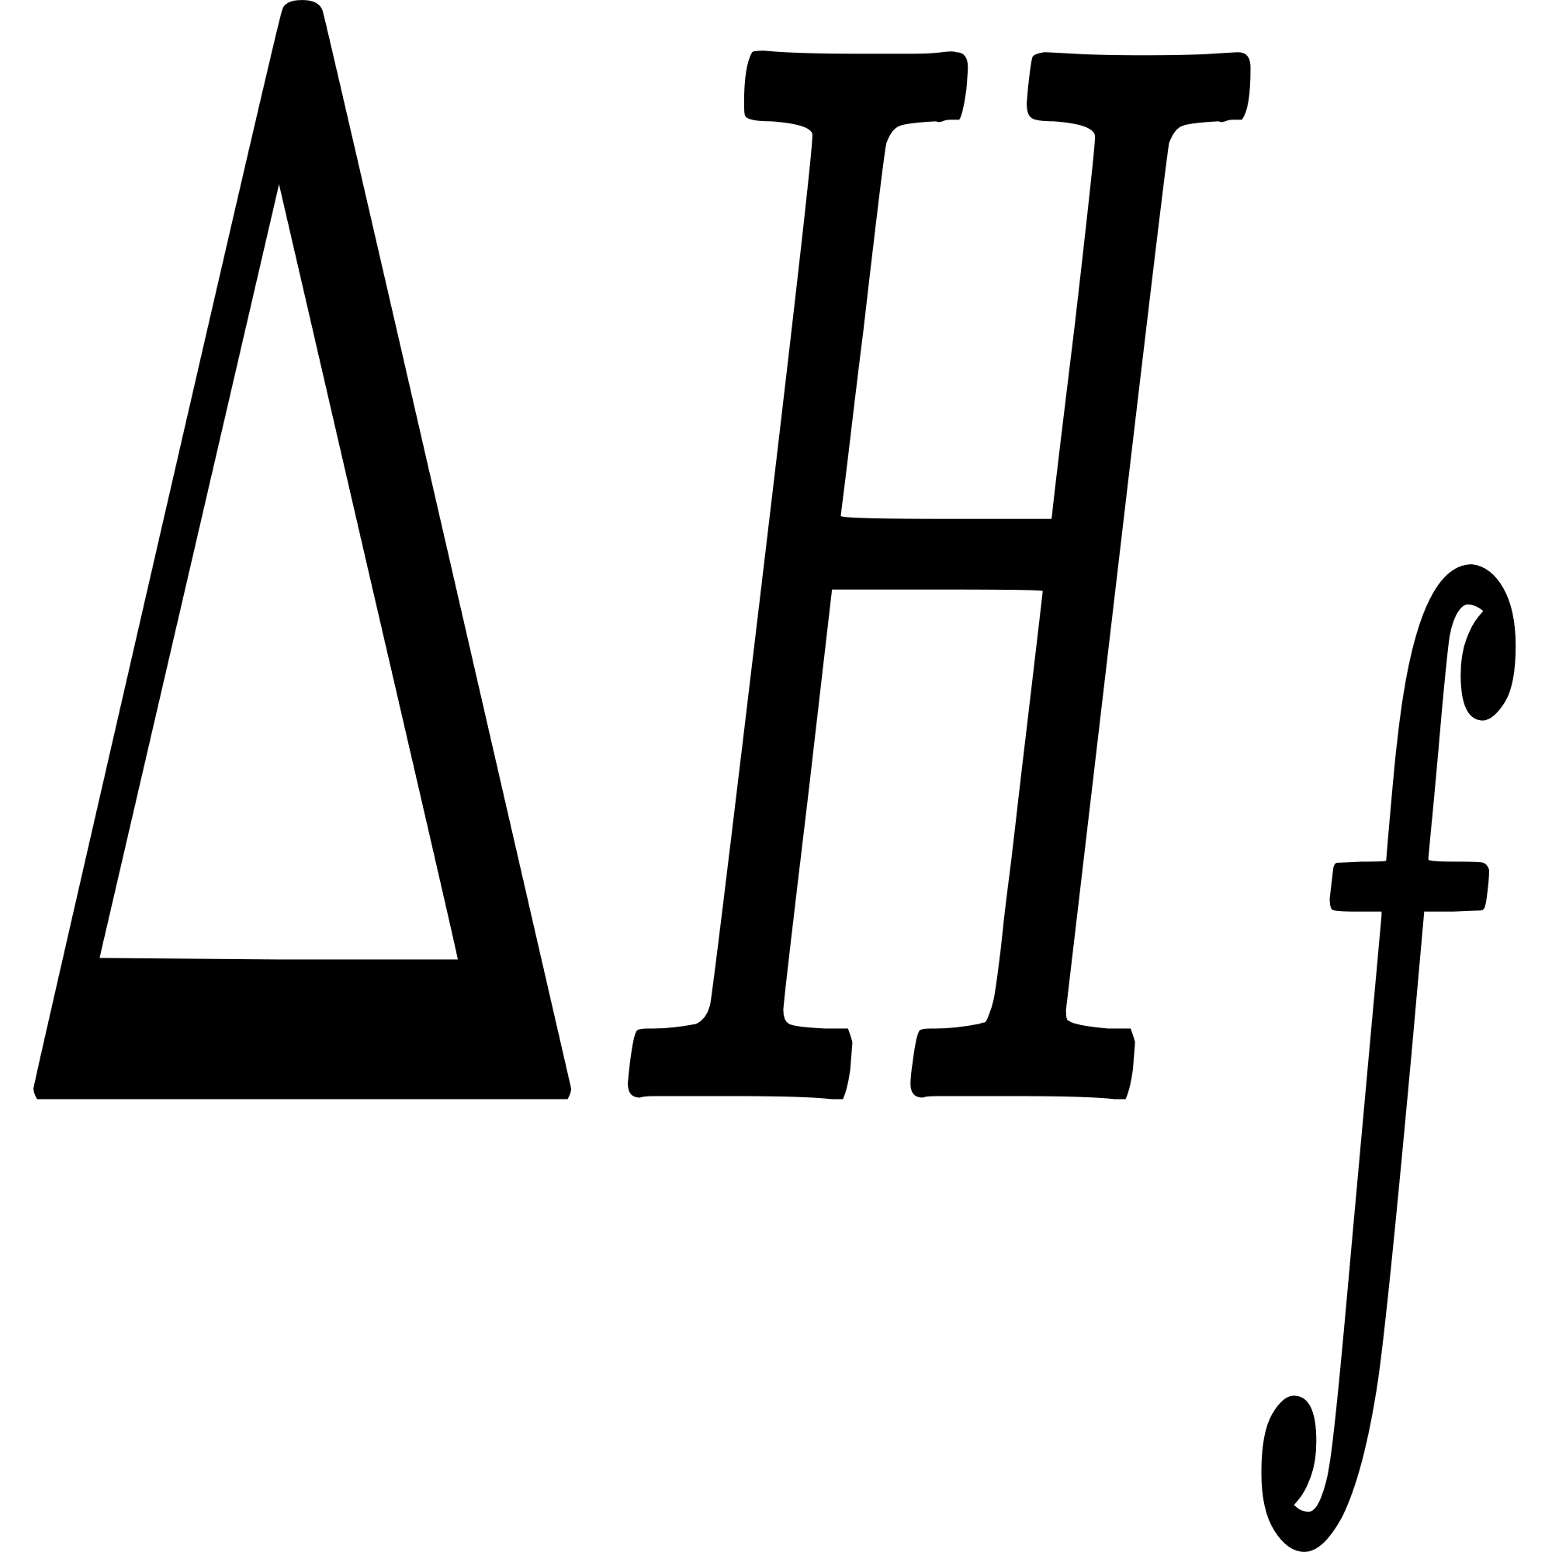
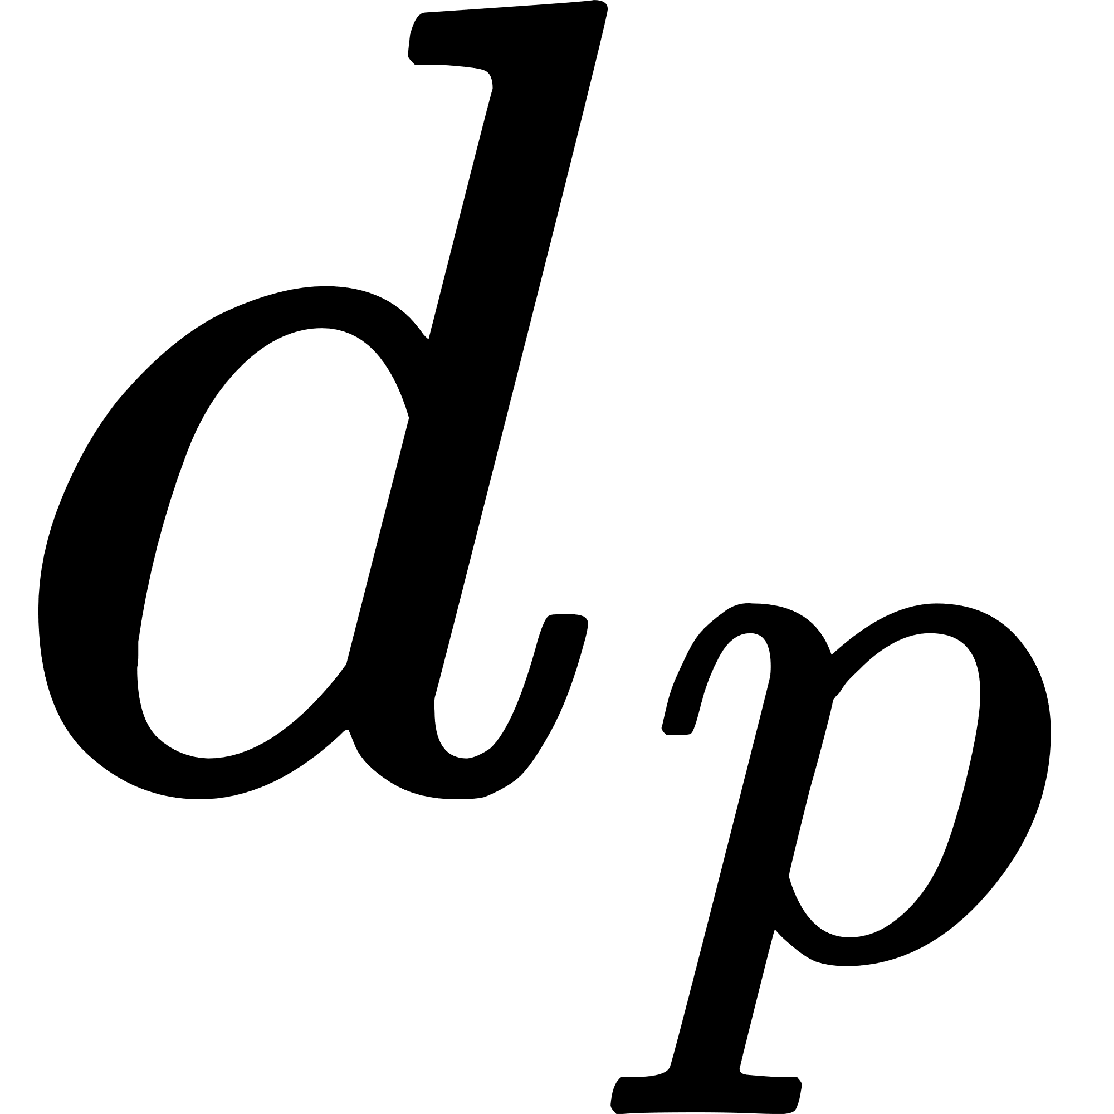
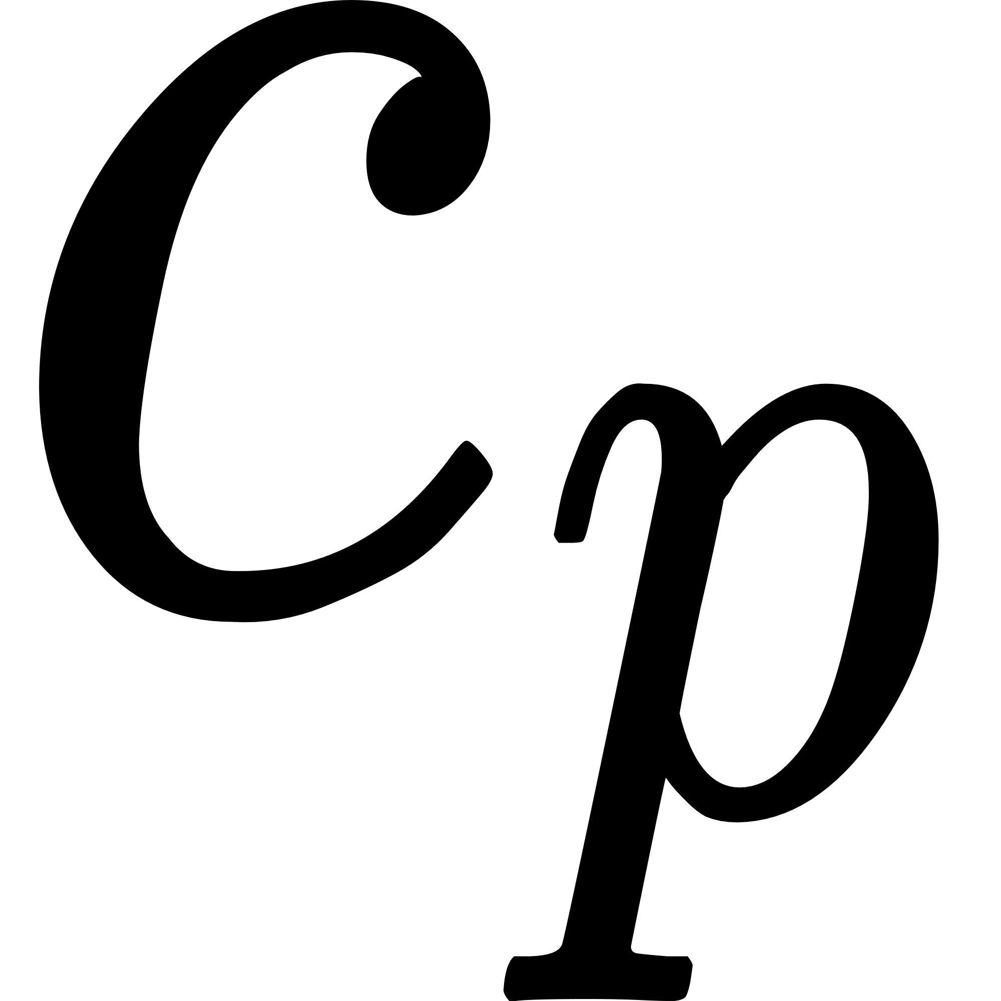
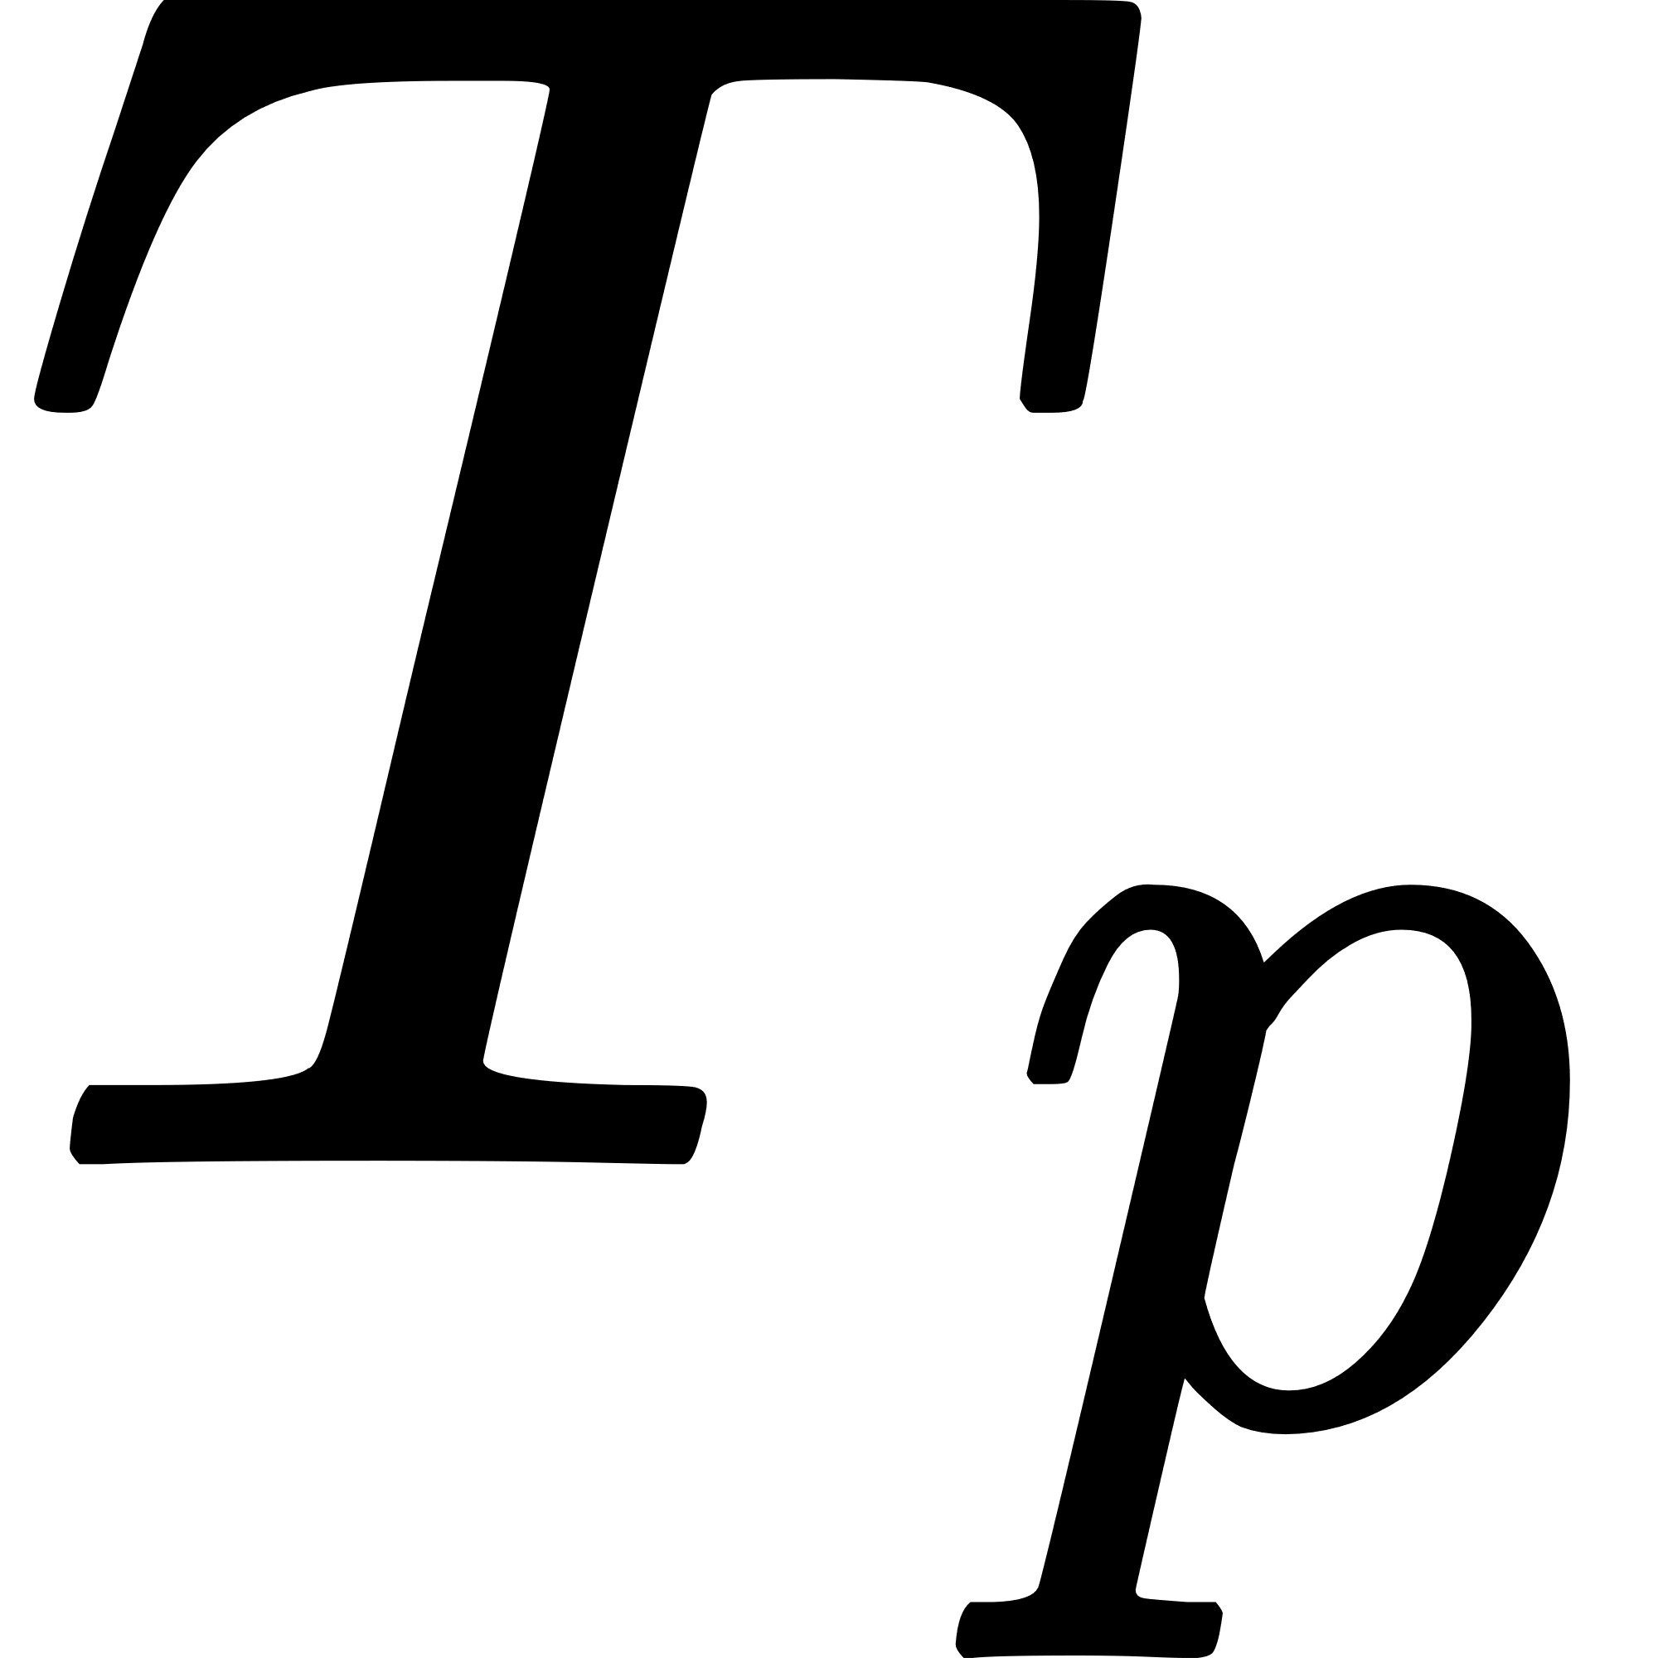
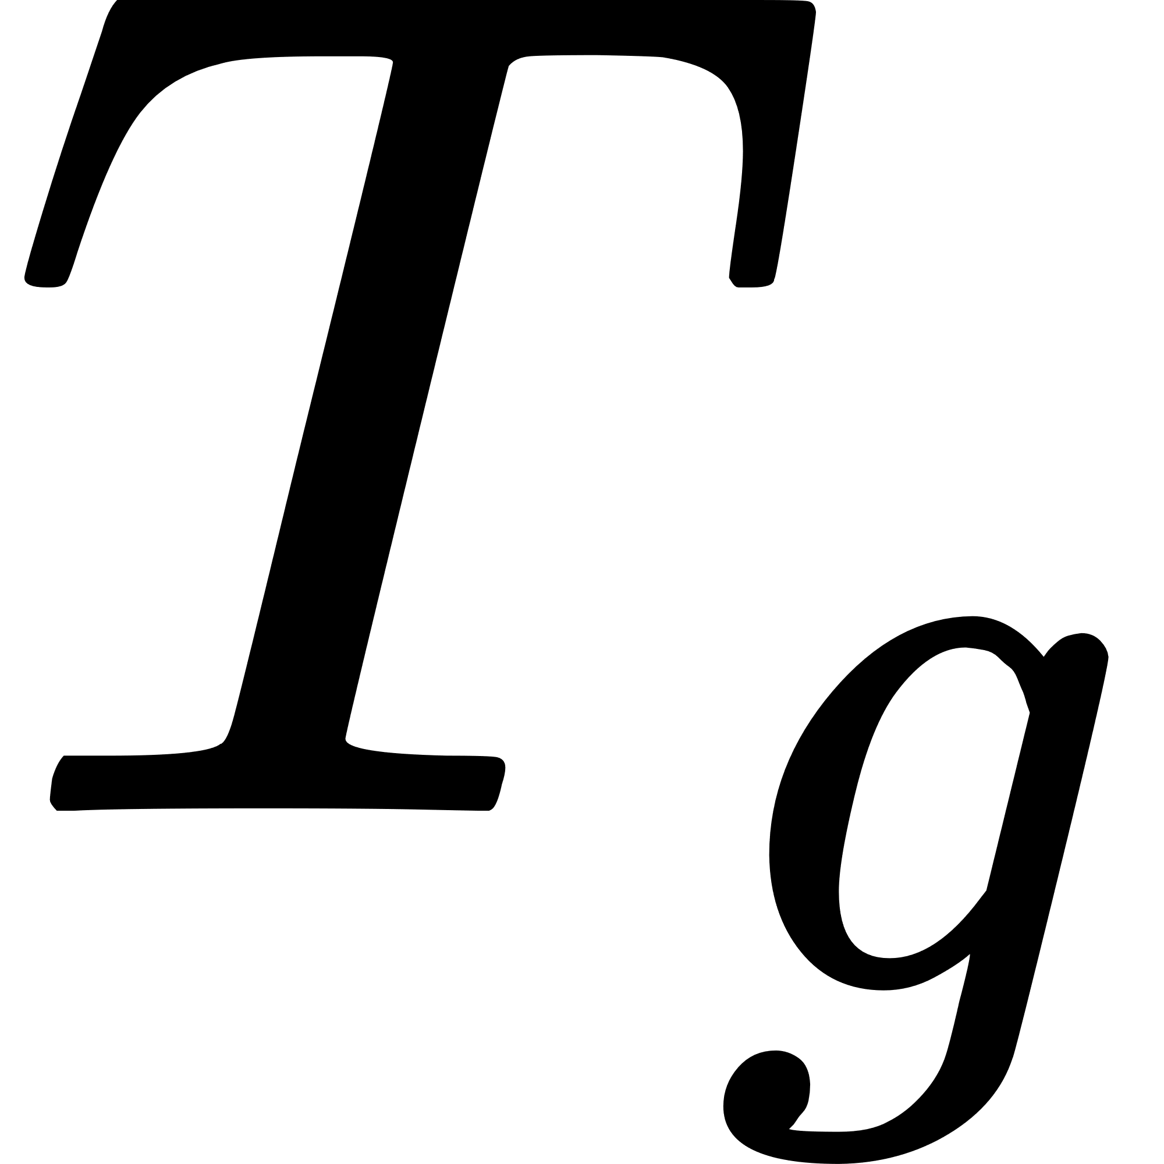
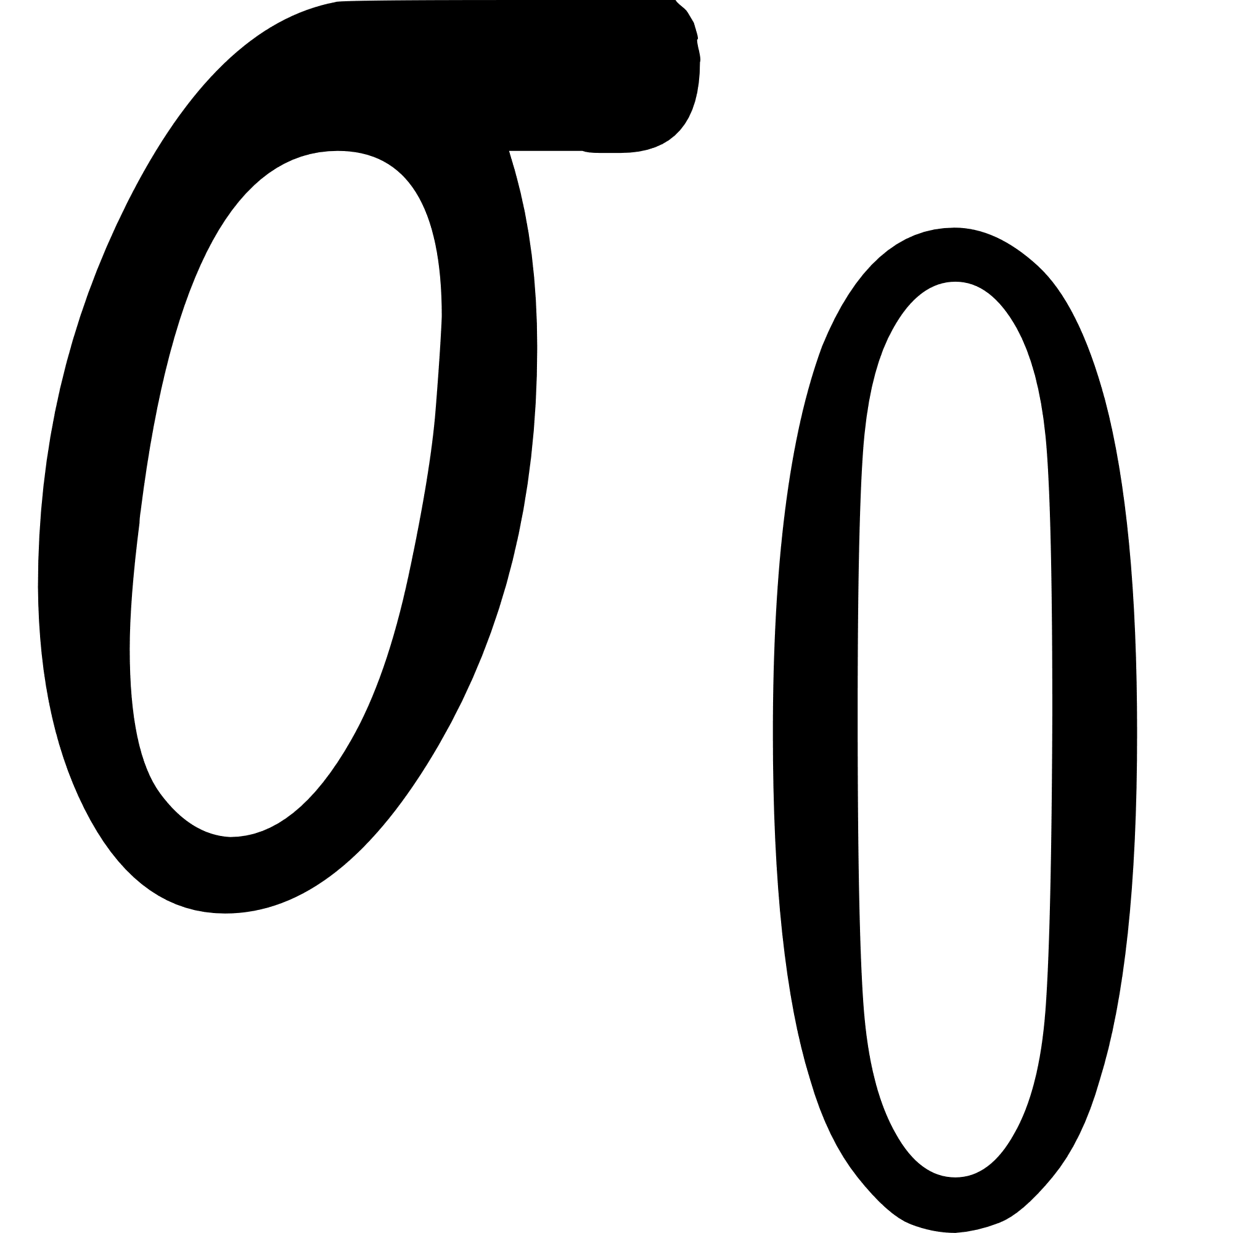
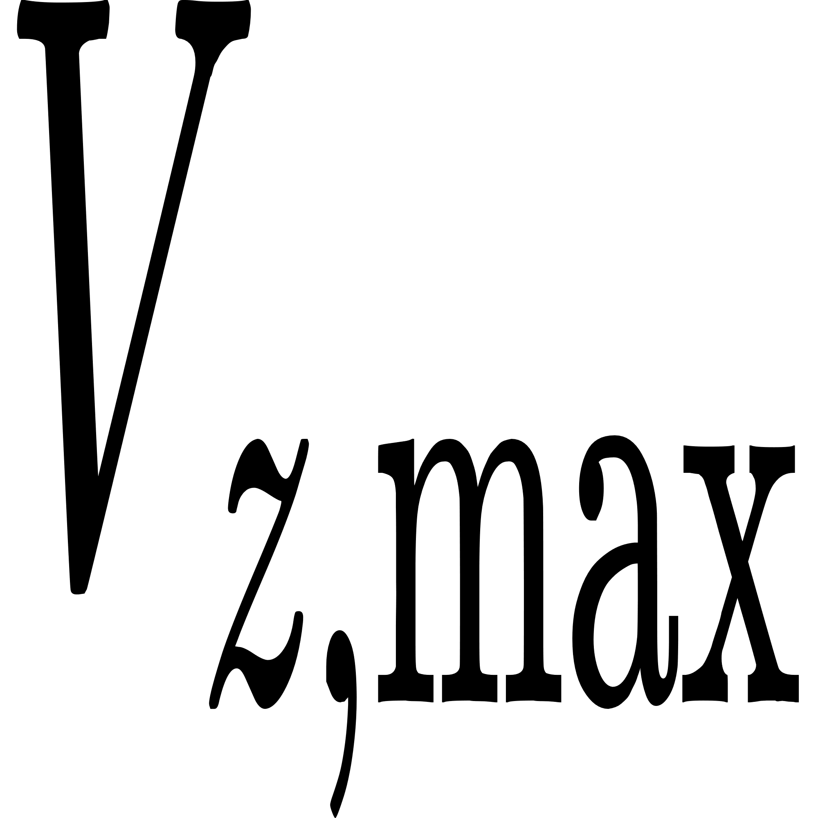
Modified Kitamura equation for particle diameter in the ligament breakup regime: -
C=61 µm
Variable | Description | Unit
 | Rate of change of particle temperature | _____K/s
 | Latent heat of fusion | 209.2×10^3 J/kg
 | Specific heat capacity of the particle | 1.247×10^3 J/(kg·K)
df/dt | Solid fraction change rate | _____1/s
α | Convective heat transfer coefficient | 372 W/(m²·K)
 | Temperature of the particle | 1723 K
 | Temperature of the surrounding gas | 293 K
 | Stefan-Boltzmann constant | 5.67×10^-8 W/(m²·K⁴)
ε | Emissivity of the particle surface | 0.9
ρ | Density of the particle | 2.5×10^3 kg/m³
 | Particle diameter | _____m
Variable | Description | Values
 | Particle diameter | _____m
R | Radius of disk | 0.1 m
Q | Volumetric flow rate | _____m³/s
ρ | Density of fluid | 2.5 * 10^3 kg/m³
μ | Dynamic viscosity | 2.1 Pa·s
δ | Film thickness | 2.5 * 10^-3 m
 | Maximum velocity | 3.72024 m/s
ω | Angular velocity | 100 rad/s
σ | Surface tension | 0.45 N/m
Li, Jun Guo, Hong Wei Lu, and Yu Zhu Zhang. "Cooling Mechanism of the Steel Slag Droplet Granulated by Gas Quenching Method." Advanced Materials Research 233 (2011): 870-876.
Ref:-
Prather, Cody A., et al. "Experimental and theoretical investigation of rotary atomization dynamics for control of microparticle size during spray congealing process." Powder Technology 418 (2023): 118278.
Ref:-
16

Slide 17
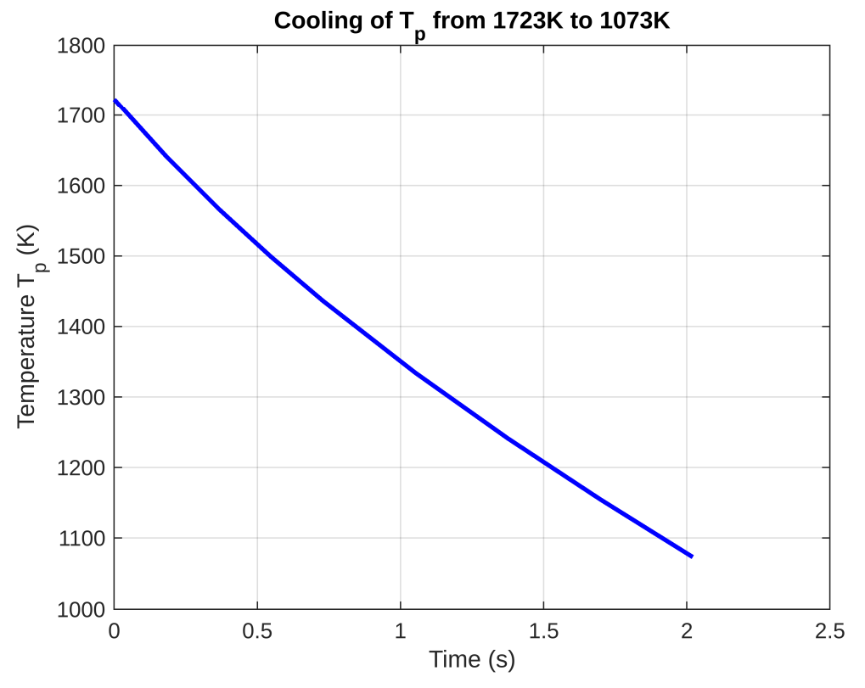
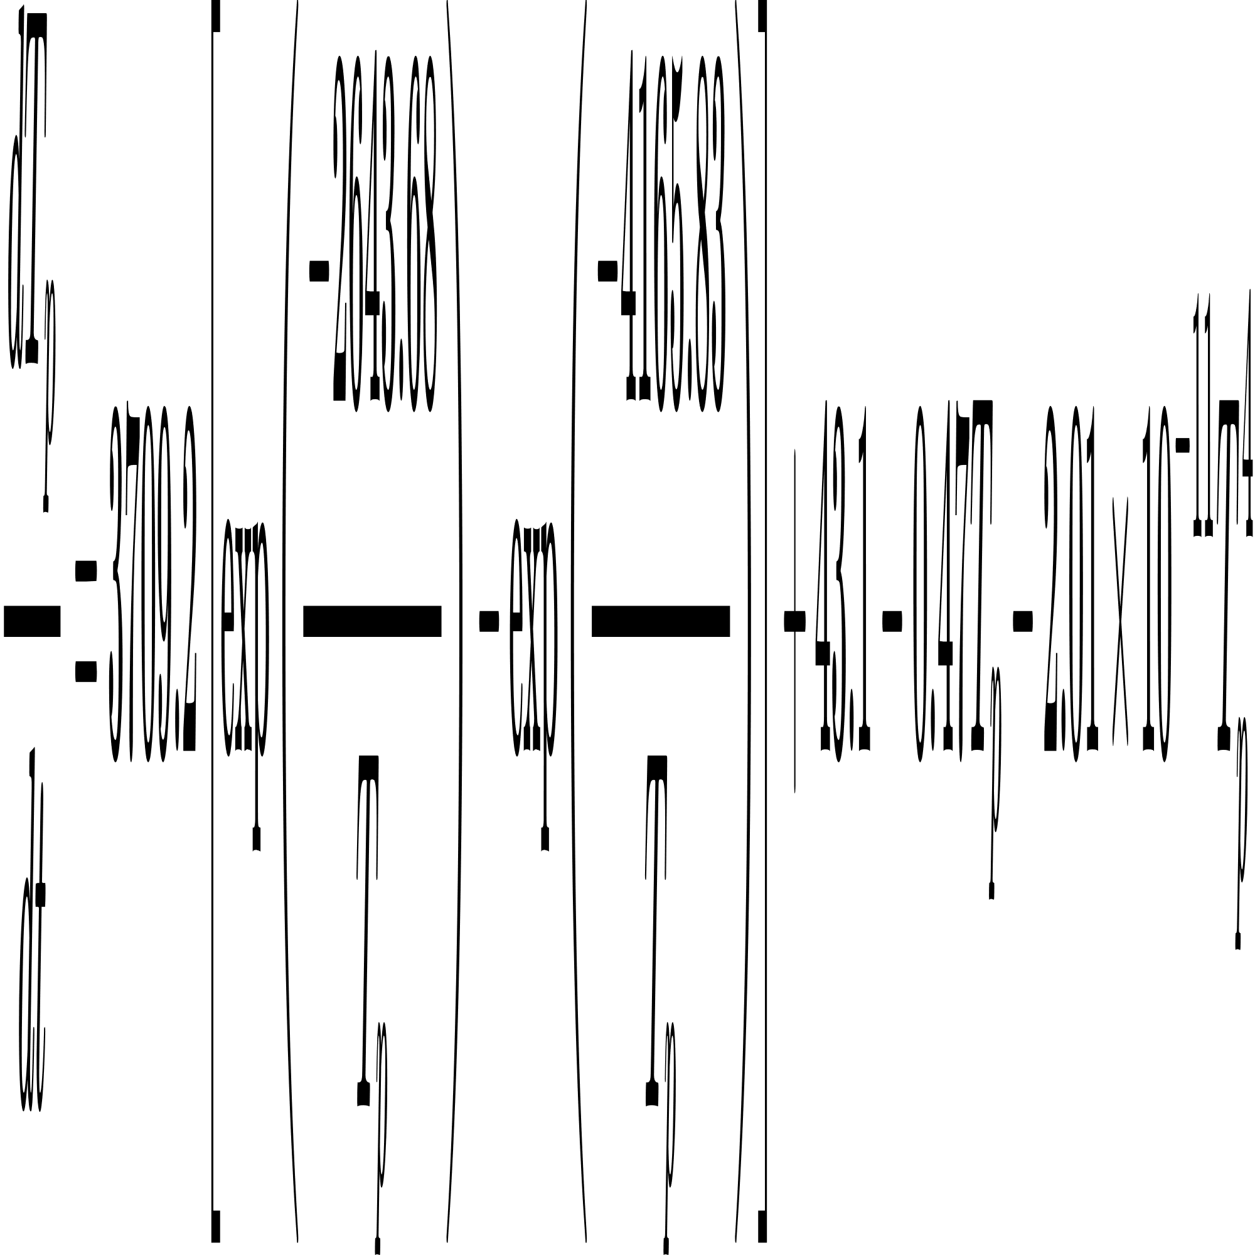
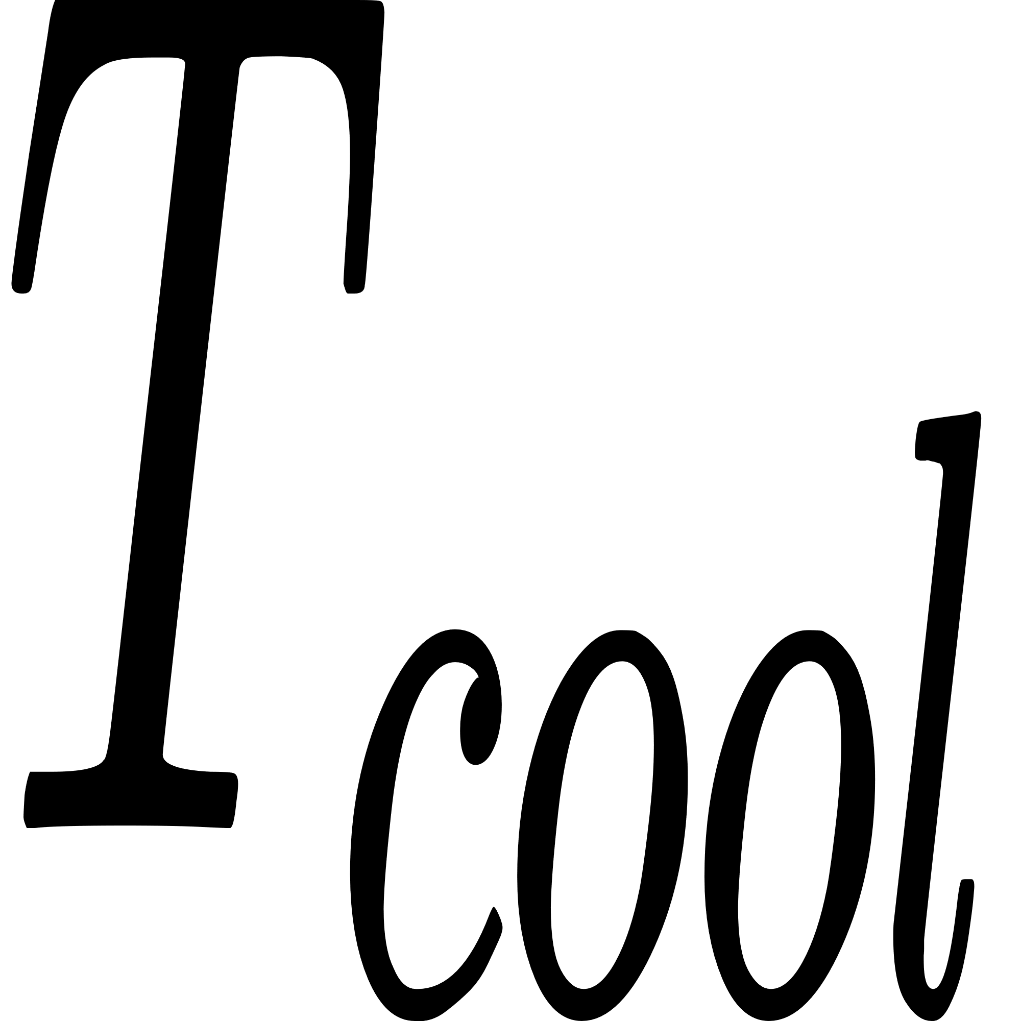
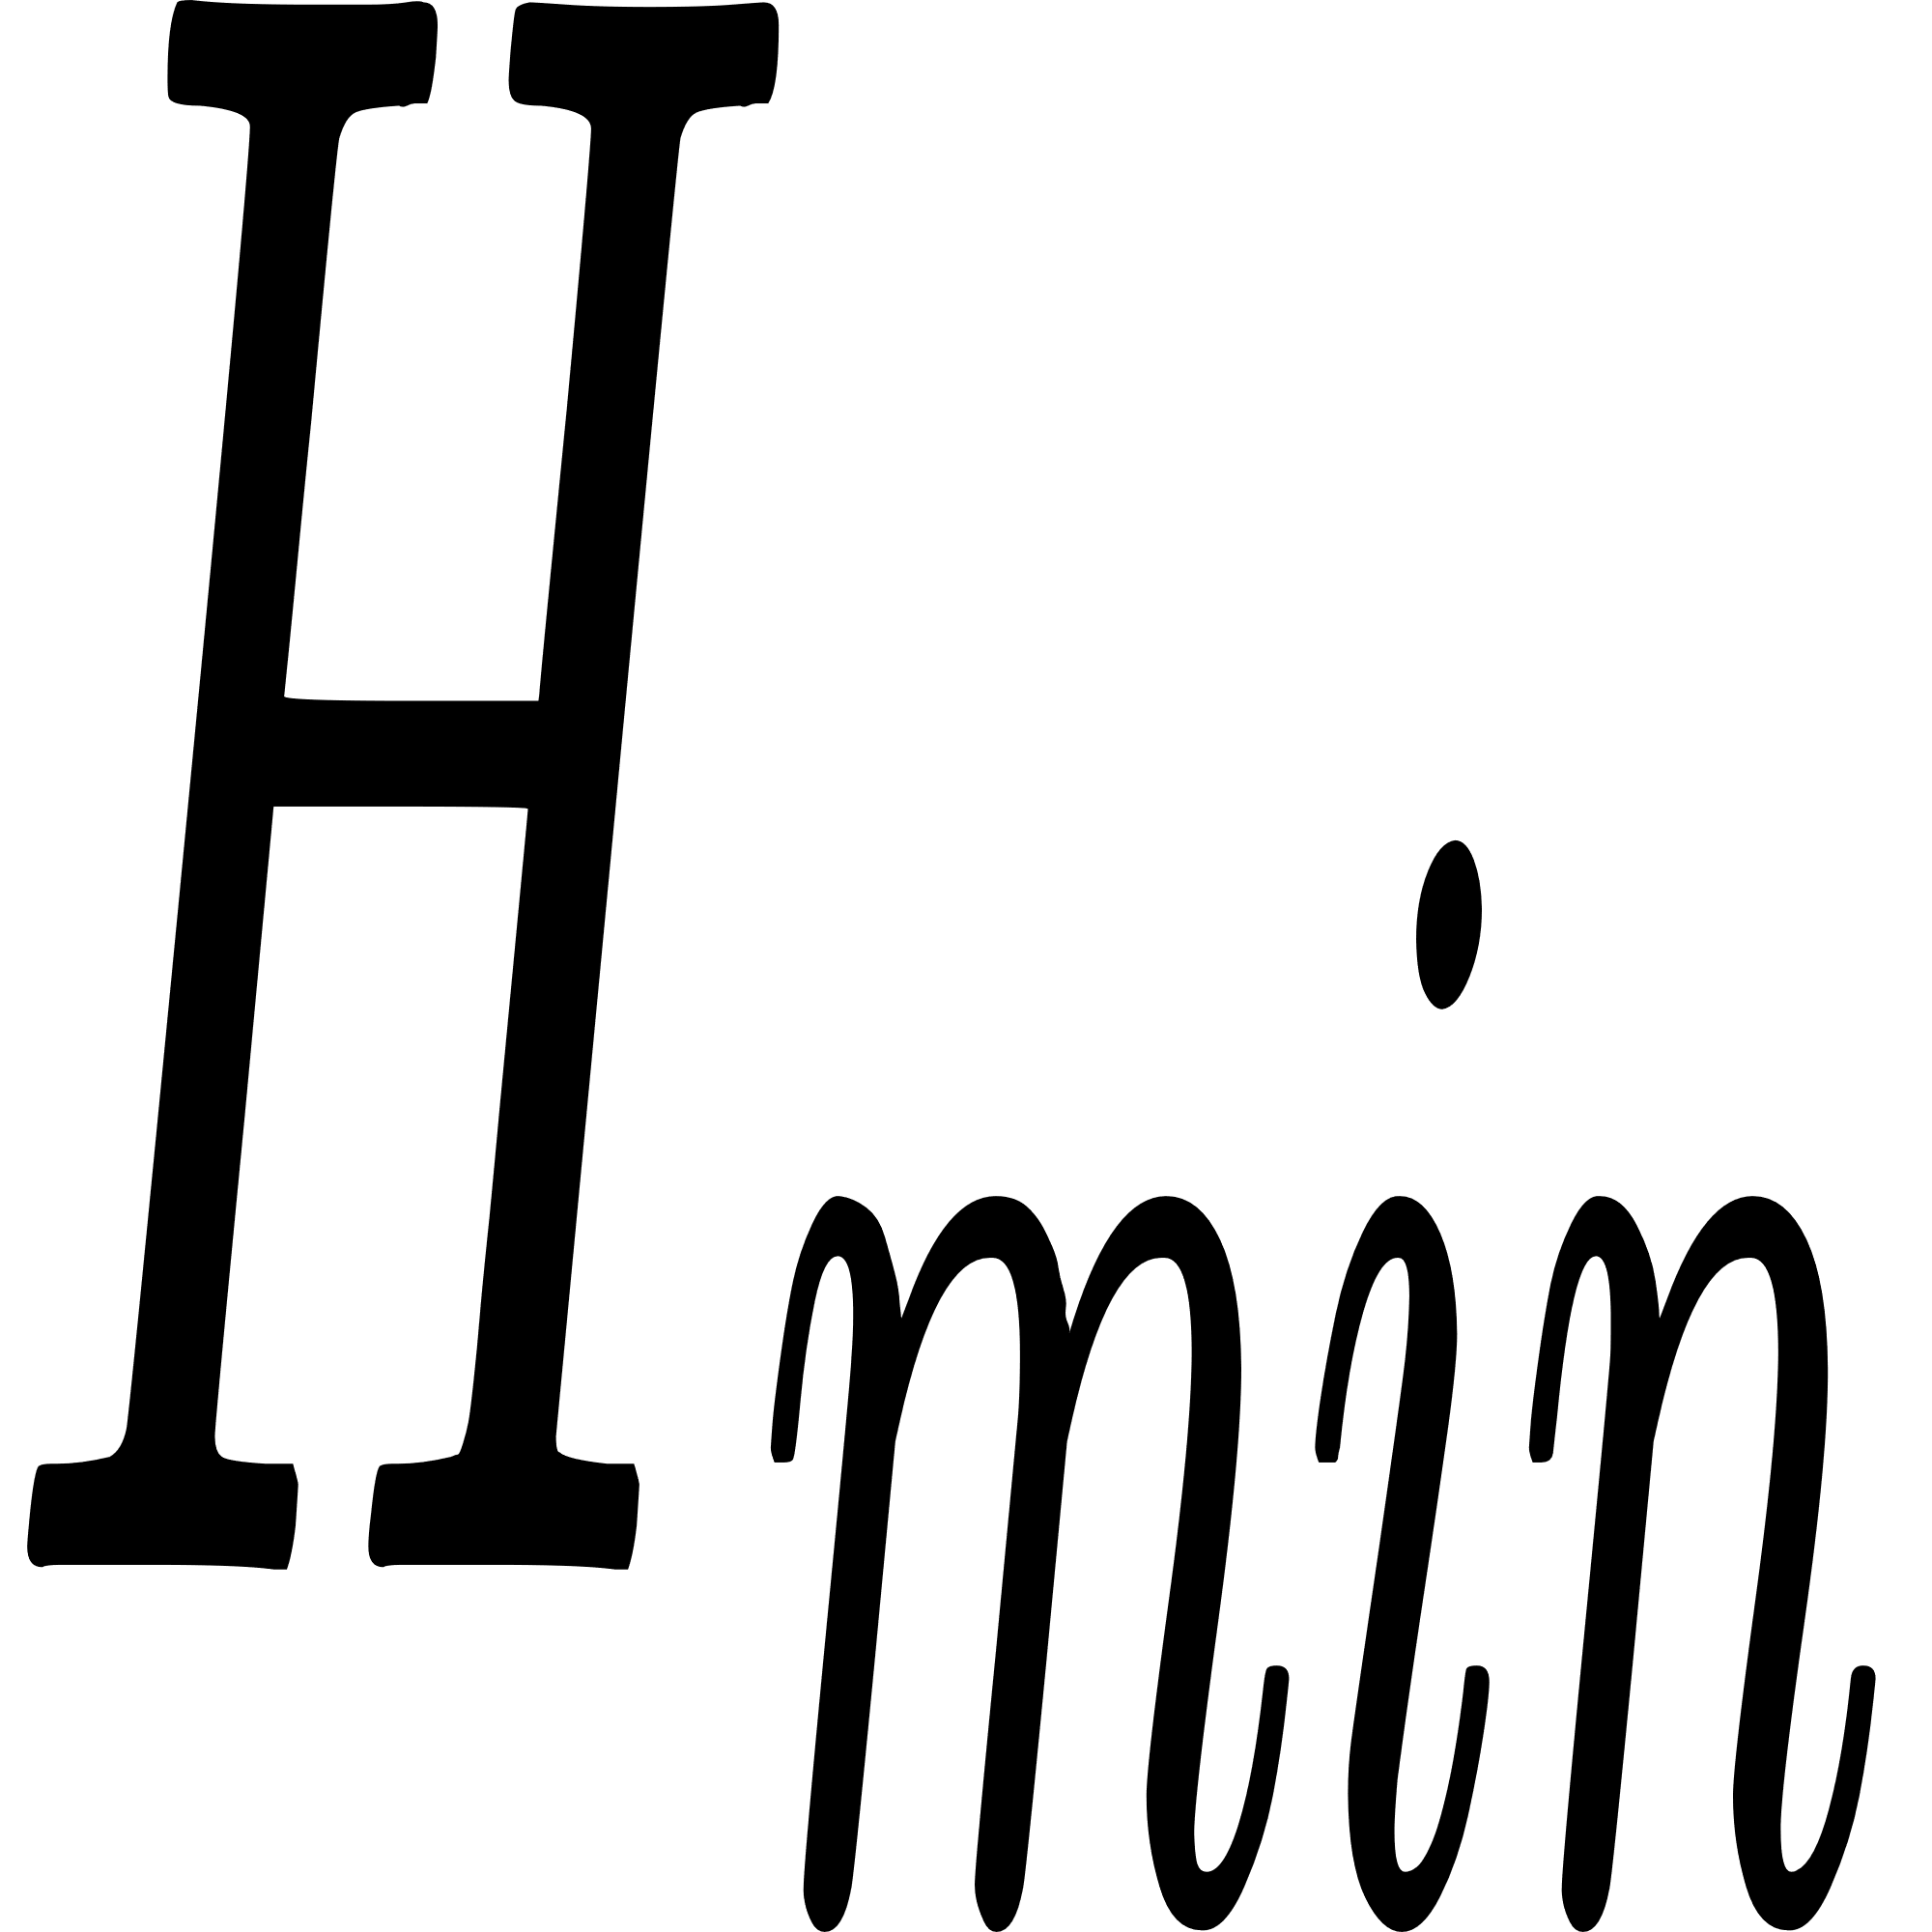
particle diameter = 4.884 mm
First-Order Droplet Solidification ODE :-
= 2.021 s
Therefore, the minimum required height of the disc from the ground is: = 20.01 m
17

Slide 18



Slide 19
Work Plan
 | BTP – I (Till Mid-Sem) | BTP – I (Till End-Sem) | BTP – II (Till Mid-Sem) | BTP – II (Till End-Sem)
Problem Identification
Literature
Model Framework
Model Enhancement
Variation Geometry
Variation μ
Variation ρ
Simulation Debugging
Documentation and Report
Completed
Not Started
18
Notes:
xyz
xyz

Slide 20
Thank You
19

Slide 21
References:
Jia, Ruidong, et al. "Effects of SiO2/CaO ratio on viscosity, structure, and mechanical properties of blast furnace slag glass ceramics." Materials Chemistry and Physics 233 (2019): 155-162.
Hurst, H. J., J. H. Patterson, and A. Quintanar. "Viscosity measurements and empirical predictions for some model gasifier slags—II." Fuel 79.14 (2000): 1797-1799.
Tsuruda, Arata, Lukmanul Hakim Arma, and Hiromichi Takebe. "Viscosity measurement and prediction of gasified and synthesized coal slag melts." Fuel 200 (2017): 521-528.
Seetharaman, Seshadri, et al. "Understanding the properties of slags." ISIJ international 53.1 (2013): 1-8.
Li, Jun Guo, Hong Wei Lu, and Yu Zhu Zhang. "Cooling Mechanism of the Steel Slag Droplet Granulated by Gas Quenching Method." Advanced Materials Research 233 (2011): 870-876.
Prather, Cody A., et al. "Experimental and theoretical investigation of rotary atomization dynamics for control of microparticle size during spray congealing process." Powder Technology 418 (2023): 118278.
Doering, Charles R., and John D. Gibbon. Applied analysis of the Navier-Stokes equations. No. 12. Cambridge university press, 1995.
20

